Slide 1
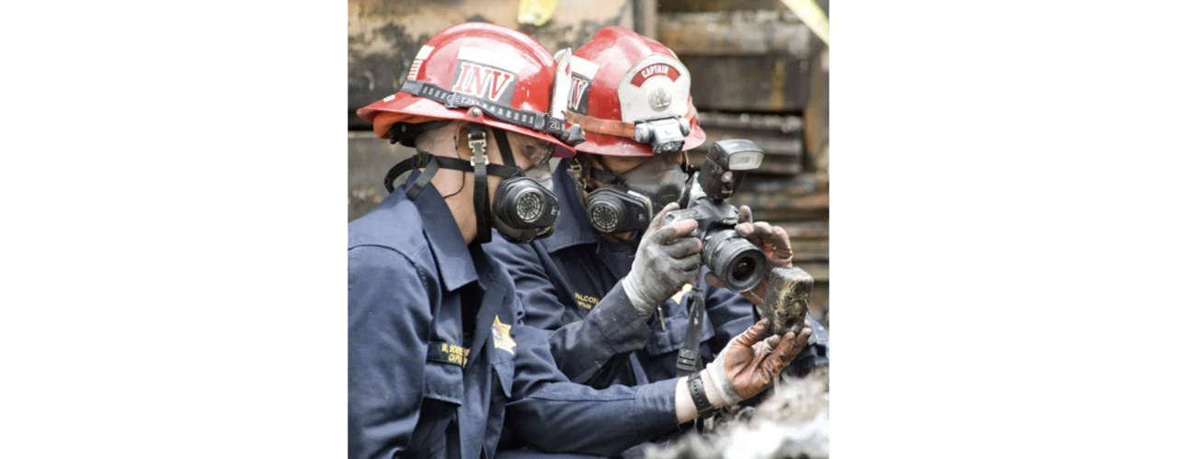
Fire Dynamics Analysis and the Computer Simulation of Fires & Explosions
Joseph M. Ellington, IAAI-CFI, NAFI-CFEI
firelogix@yahoo.com
https://aifirelogix.com
1
1
1

Slide 2

Objectives
Play Narration
Explain modeling in general and the differences between a model, simulation, and an animation.
Dispel the myths surrounding fire simulation and explain its usefulness.
Explain what Fire Dynamics Simulator (FDS) is, how it can be used as a tool in forensic fire investigation, and how its results may be analyzed and interpreted.
Explain the limitations and mistakes that are commonly made by the users of FDS.
Knowledge is taken from wherever it is found. Knowledge is useless, however, unless properly applied.
2
2
Notes:
The purpose of this presentation is not to teach investigators to investigate a fire or use Fire Dynamics Simulator (FDS) to simulate a specific fire. Rather, its purpose is to remove the mystery surrounding modeling, simulation, and animation, and to familiarize investigators with the use and application of FDS as a tool for investigating a fire.
Click the Next button below to continue.

Slide 3

Decoding Fire Investigation
Play Narration
Over time the investigation of fire has evolved from a simplistic approach to one of understanding and analyzing fire using a more complex Systems Approach that considers and involves four (4) factors.
Human
Building
Environmental
Fire
3
3
Notes:
Over time, the investigation of fire has evolved from a simplistic approach to one that involves understanding and analyzing fire using a more complex Systems Approach, which considers and incorporates four key factors: human behavior and actions, the building, the environment, and the fire itself.
In the past, the final outcome of a fire investigation depended largely on witness description and the perceived experience, wisdom, and authority of the investigator. Technology and the legal process have driven the need and requirements of fire investigation toward a science-based methodology, best characterized and captured within the guidelines of NFPA 921. These specific procedures establish a profession-wide framework for conducting effective investigations and improving the probability of reaching sound conclusions.
Fire models, simulation, and animation are useful for performing and documenting fire dynamics analyses and can be a valuable tool in fire investigation and litigation, establishing whether the principles recommended by NFPA 921 were adhered to. Formal fire models were originally developed by the fire protection engineering discipline primarily to avoid the hazards and expenses of actual, full-scale testing and to evaluate the fire hazards of materials and building designs. They were soon adopted for forensic applications. However, they do not replace, nor can they substitute for, a properly conducted origin and cause investigation and failure analysis.
Click the Next button below to continue.
.

Slide 4
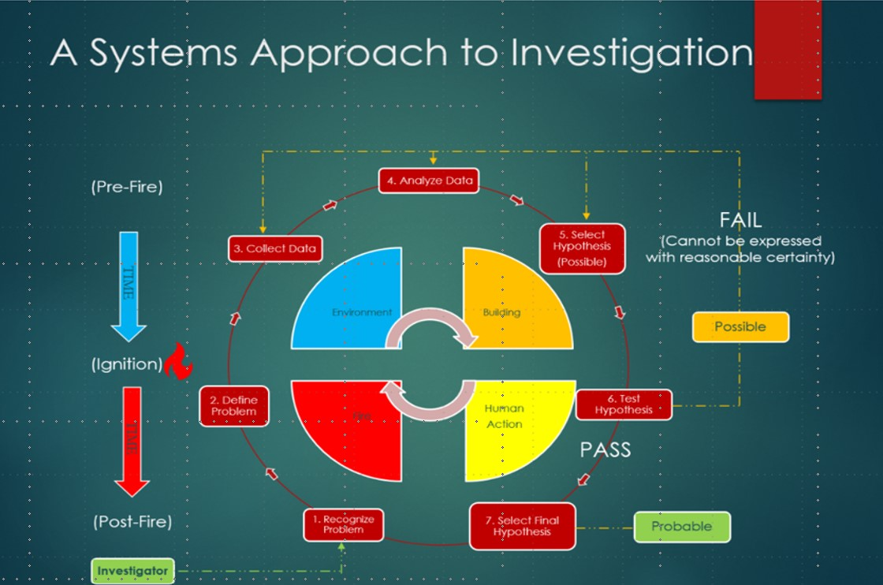
A Systems Approach to Fire Investigation
Play Narration
The current investigation of fire involves a Systems Approach and the application of a more advanced model of performing a Fire Dynamics Analysis.
Simulation is one way of transparently verifying the accuracy of an investigator’s opinions or conclusions and one way to demonstrate compliance with NFPA 921.
The systems Approach to fire investigation was first proposed by AIFireLogix and published in the IAAI Fire & Arson Journal (Jan 20 ed.)
Systems Approach diagram first published in the IAAI Fire & Arson Journal (Jan 20 ed.)
4
4
Notes:
The graphic shown on the screen incorporates all the elements involved in the systems approach to fire investigation. The systems approach is not a new concept, based on the premise that breaking down a complex concept into simple, easy-to-understand units facilitates a better understanding of its complexity. The Scientific Method, described in greater detail in NFPA 921, is overlaid on top. A systems approach focuses on the holistic entity of the system without neglecting its components and attempts to understand the role of each component while simultaneously understanding the activity of the entire system.
Human behavior and actions play a significant role in the development of fires. Although there are many commonalities among individuals, they may exhibit varying sensitivities to fire effluents based on factors such as age, mental capacity, physical disabilities, medication, and substance use. Understanding these differences can help assess why a person did not escape a burning structure, was injured, or died during a particular fire.
Individuals, for example, exhibit complex and unpredictable behaviors and responses in fire situations that comprise human action. Factors such as panic, fear, and the desire to help or not abandon others can influence their actions during a fire. The timing and manner in which a fire is responded to or suppressed by the fire department can affect its behavior.
The building’s geometry and its contents significantly impact a fire’s visibility, temperature, and the accessibility of egress paths, playing a crucial role in occupants' ability to escape safely. The building’s fire protection system responses, including smoke detector and sprinkler activations, department response times, and fire suppression decisions and actions, also affect a fire’s detection and development.
Environmental Factors, such as weather conditions (e.g., temperature, precipitation, elevation, the velocity and direction of surface winds, and lightning), can affect ignition and may often precede or change during a fire, influencing the way the fire behaves. Although both types of ventilation (Passive and Active) affect fire behavior, passive ventilation allows fresh air to circulate through a building without the use of mechanical systems, such as fans or air conditioning units. It relies on natural forces such as wind and buoyancy to move air. Active ventilation involves using mechanical systems to control the airflow within a building.
Fire is also influenced by fuel, heat, and oxidant, all of which are essential in analyzing the progression of a fire. A fire scenario is a hypothetical situation used to simulate and analyze the behavior of fire in a specific environment. The simulation of fire scenarios can predict fire behavior and assess the impact of different variables on the outcome of a fire incident. The threshold criteria of tenability, developed through research and building codes, provide guidelines for assessing the ability of occupants to escape or their survivability in a fire.
The systems Approach to fire investigation was first proposed by AIFireLogix and published in the Jan 2020 ed. of the IAAI Fire & Arson Journal and may be downloaded by clicking on the graphic.
Click the Next button below to continue.

Slide 5
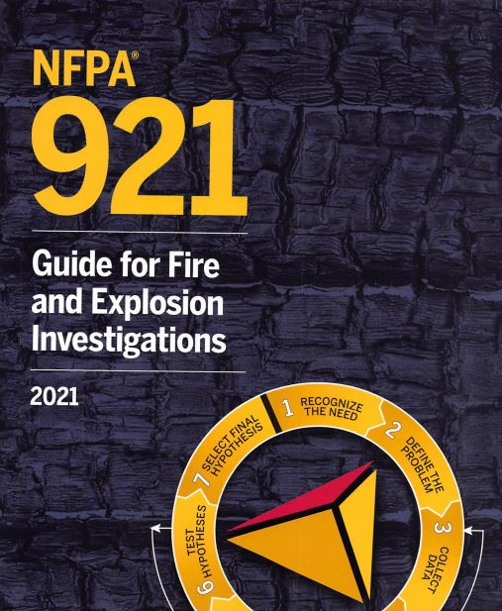
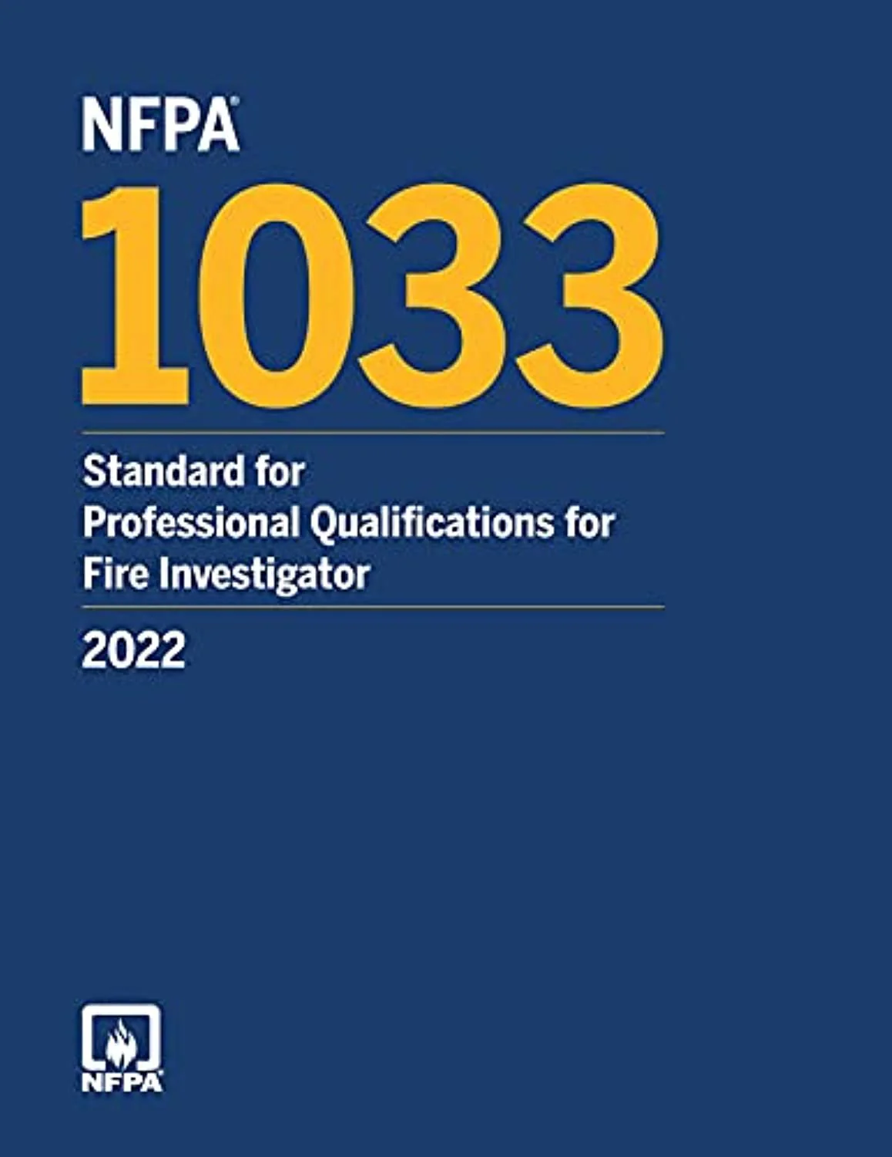
Play Narration
NFPA 921& NFPA 1033
In the past, the expert opinions of a fire investigation depended largely on witness description and the experience (real or perceived) and authority of the investigator.
NFPA 921 recommends the investigator adhere to a methodology accepted by a consensus of professionals knowledgeable in basic fire science and fire dynamics and have the experience, knowledge, and training described in NFPA 1033.
5
5
5
Notes:
The reluctance of fire investigators and the courts to embrace fire simulation as a reliable tool and apply it to fire investigation is particularly noteworthy in light of the general acceptance and reliance on other tools or methods, such as fire pattern analysis, for determining the origin, cause, and development of fires, which arguably demonstrate error rates as high or higher. The same criticism could be leveled against any fire investigation where a fire investigator employs an experience-based methodology to perform a fire dynamics analysis and does not fully document or validate their conclusions or effectively identify their error rate.
Fire investigators essentially construct an initial simulation of the fire’s origin, cause, and development. This is an informal mental process, seldom involving transparency, and usually does not involve the calculation of mathematical equations derived from fundamental scientific principles, but rather a reliance on what the investigator has been taught, learned from others, or gained through experience concerning fire science and fire behavior. Evidence or indicators, such as fire patterns, arc mapping, and witness statements, most often support the investigator's conclusions.
In essence, the investigator narrows the universe of possible fire origins using inductive logic before testing a final possible hypothesis with deductive logic. Inductive logic is a form of reasoning that involves drawing general conclusions from specific observations or instances. It begins with specific observations or data points, identifies patterns or irregularities in the observations, forms a general conclusion or hypothesis based on the identified patterns, and assesses the probability that the hypothesis is true. The investigator then uses deductive logic to test the hypothesis. Unlike deductive logic, which starts with general premises and moves to a specific conclusion, inductive logic works in the opposite direction.
Once the location where a fire begins (or its origin) is determined, then its cause can be determined using the same process. These activities give rise to a premise generally accepted throughout the fire investigation profession. That is, the origin of a fire must first be determined correctly before its cause can be. NFPA 921 establishes a profession-wide framework for conducting effective investigations, thereby improving the probability of the fire investigator reaching sound conclusions.
Technology and the legal process have driven the need and requirements of fire investigation toward a science-based methodology, best characterized and captured within the guidelines of NFPA 921, which outlines specific procedures. NFPA 921 is a living document in progress that summarizes the evolution of fire investigation from an experience-based process to a science-based one, providing a profession-wide framework for conducting effective investigations. NFPA 921 improves the likelihood of reaching sound conclusions but does not guarantee it.
Click the Next button below to continue.

Slide 6


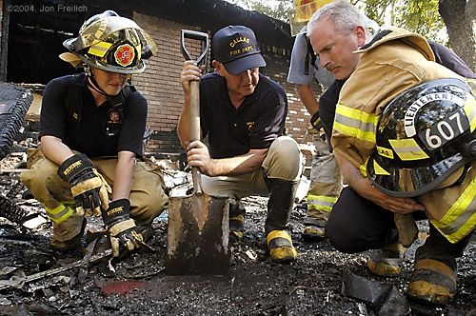
Play Narration
Simulation is a tool of Fire Investigation
Fire investigation is the process of determining the origin, cause, and development of a fire. It may provide the basis for establishing property damage, injury, or loss of life
Fire dynamics is the study of how chemistry, physics, fire science, engineering disciplines of fluid and solid mechanics, and heat transfer influence fire behavior.
Simulation can not establish either the origin or the cause of a fire, replace a properly executed fire investigation, or repair a flawed one.
6
6
6
Notes:
The underlying basis for identifying the origin, cause, and development of most fires involves a compartment fire, which represents an enclosure where the fire begins, develops, and is either extinguished or escapes its confines, threatening the building or its occupants. Fire patterns have historically been and continue to be the primary tool used by fire investigators to determine the area of origin. Together, a fire investigation and Fire Dynamics Analysis may determine the origin of a fire and its cause.
Computer simulations are based on fire science principles that most fire investigators are familiar with and have extensive experience in. The use of computer fire simulation can be a valuable tool in validating and/or refuting a fire investigator’s. conclusions. The simulation of fire is based on the fundamental principles of fire science, described in mathematical equations, and simulations are used to calculate the simulation’s output (solutions).
Hypotheses are developed not only for the cause of a fire but also, importantly, for the area of origin. The origin hypothesis is important because the area of origin must first be determined before a cause can properly be evaluated. In effect, determining the origin of a fire narrows the universe of possible fire causes. The primary use of simulation is to test a fire investigator’s conclusions, either to see how closely the hypothesis conforms to basic fire science and fire dynamics and, in the case of competing hypotheses, which hypothesis is closer to conforming to the facts and evidence.
Click the Next button below to continue.
.

Slide 7

Play Narration
Chemistry and Physics
The study of fire involves both chemistry and physics.
Chemistry frequently involves micro (e.g., ignition) rather than macro (e.g., fire development) concepts and often involves the properties of matter, whereas physics involves dynamics or how things happen.
Although one proceeds the other, often they can not be separated but involve interaction and influence each other.
Understanding each makes it easier to assemble the details as you encounter them and see where they fit into the bigger picture.
Chemistry
Physics
Fire
Ignition
Development
7
7
Notes:
The underlying process of all fires is based on the fact that significant and complex interdependent relationships exist between the mass burning rate, the rate of heat release, and the available oxygen, usually found in air, during the fire. During this process, fire tends to follow fundamental laws of chemistry and physics that have been identified, accepted, and developed, and form the basis for fire dynamics that investigators interpret after the fact. If this were not true, fire investigation would indeed be an art based solely on experience rather than a science. To understand fire or, by extension, Fire Dynamics Simulator, fire investigators must understand the following concepts, or at the very least, know where to find this knowledge.
Although Chemistry and Physics both play a role in the ignition and development of a fire, Chemistry frequently involves micro (or ignition) rather than macro (fire development) concepts, and often focuses on the properties of matter, whereas Physics involves the dynamics of fire or how a fire develops. Although one precedes the other, they are often not separable but rather involve interaction and influence each other. Understanding each makes it easier to assemble the details as you encounter them and see where they fit into the bigger picture.
Fire investigators must understand the chemical reactions involved in combustion, including how different materials ignite and burn. Knowledge of the mechanisms of heat transfer through conduction, convection, and radiation helps investigators determine fire spread patterns. Understanding the behavior of fire, including flame temperature, smoke movement, and the effects of ventilation, is essential to comprehending fire dynamics —the process by which a fire develops. Understanding the material properties of fuels that comprise the structure and its contents helps investigator understand how various materials react to heat and fire, including their melting points, ignition temperatures, and flammability.
Both chemistry and physics play important roles in analyzing fires. Chemistry is more important to ignition and early fire development, while physics becomes more important during a fire’s later stages of development. All of these may be questioned during a reasonable examination of a fire’s ignition and development. Because of this, the investigative process must be systematic, the methodology sound, the logic reasonable, and attention paid to detail. Otherwise, the fabric of an investigator's conclusions will unravel when subjected to the reasonable examination of others.
The Certified Fire and Explosion Investigator (CFEI) program, offered by the National Association of Fire Investigators, and the Certified Fire Investigator (CFI) program, offered by the International Association of Arson Investigators, provide standardized training and certification in these areas. These concepts are crucial for establishing the credibility of any fire investigator or other expert who testifies in court regarding the origin or cause of a fire. In addition, Fire investigators are required by NFPA 10133, Standard for Professional Qualification for Fire Investigators, to engage in ongoing education with these concepts and to stay current with new techniques, technologies, and scientific advancements.
Click the Next button below to continue.

Slide 8

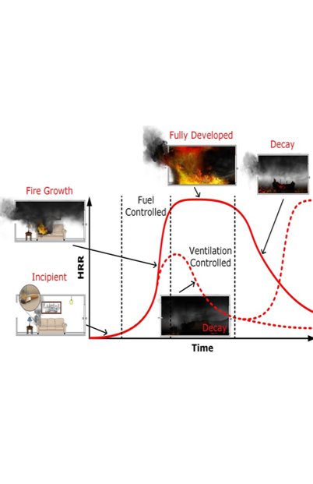
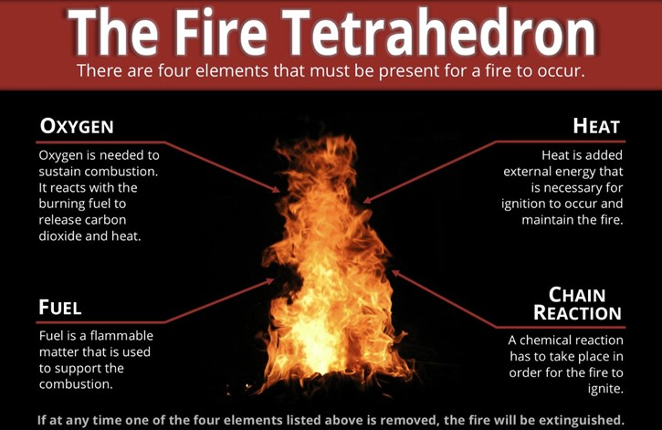
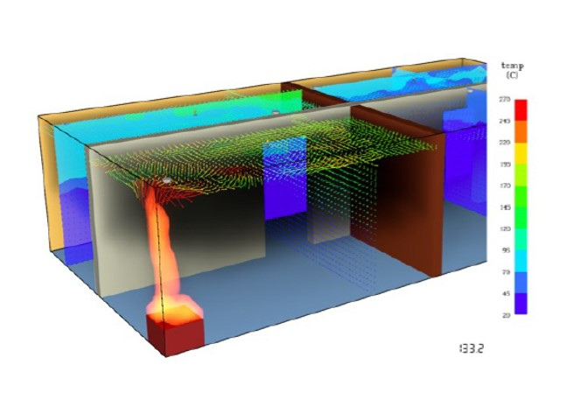
Play Narration
What is Modeling and why does it work ?
Fundamentally, a model is an idealized representation of a physical system that is too complex to analyze easily or fully without simplification.
All fire simulations are based on sub-models that, together, create their output.
8
Notes:
The goal of fire modeling is to uncover the laws governing fire and to express these laws in mathematical terms that can be used to predict its behavior. Fire simulation uses these laws to calculate and visualize its predictions.
The Fire Tetrahedron is a simple model that explains the necessary ingredients of most fires and graphically illustrates the four criteria required for a fuel to ignite and a fire to continue burning. That is, fuel, heat, an oxidant (usually atmospheric oxygen), and, lastly, a chemical chain reaction.
The Fire Tetrahedron serves as the foundation for those involved in fire detection, suppression, and extinguishment, as well as for identifying its origin and cause through further analysis and investigation. The principles of the Fire Tetrahedron, although simplified, are converted into mathematical equations and used to create more complex models that, together, form sub-models that serve as the basis for simulations like FDS. They are also based on the laws of conservation of mass, momentum, and energy that, together, provide a comprehensive framework for analyzing and understanding the complex processes involved in fire and combustion.
Click the Next button below to continue.

Slide 9
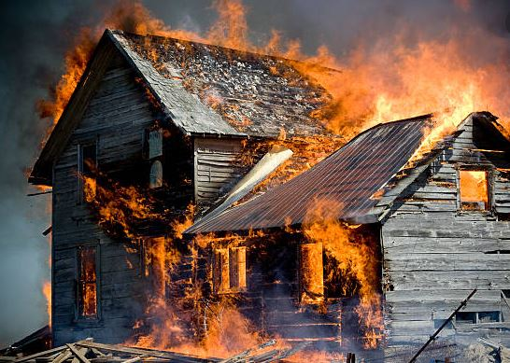
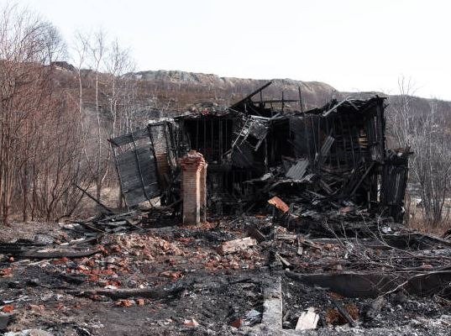
Play Narration
Conversion of matter and energy.
Energy in the form of light or heat are produced during an uncontrolled fire but no useful work is performed. Matter is only converted to a different form.
8
9
9
Notes:
In nature, nothing is given away for free. The law of Conservation of Mass is a law that states that mass is neither created nor destroyed in a chemical reaction. In the context of fire, it means that the total mass of the reactants (fuel and oxygen) equals the total mass of the products (carbon dioxide, water, and other byproducts). This helps us balance chemical equations and predict the amounts of products formed during combustion.
In the context of combustion, the chemical energy within matter is related to its chemical bonds. The question is sometimes asked, “Where does matter go during a fire? Is it consumed by fire, or does it just disappear? It may seem, for example, as though burning destroys matter, but the same amount, or mass, of matter still exists after a fire as before, as shown. For example, when wood burns, it combines with oxygen and changes not only to ashes but also to carbon dioxide and water vapor. The gases float off into the air, leaving behind just the ashes. In fact, although converted to a different form, if we could measure the mass of the wood before it burned, the oxygen used by the fire, and the mass of all the components to which it was converted, including the gases that were produced, the total mass of matter after the fire would be the same as the total mass of matter before the fire).
During a fire, combustion reactions occur (which are chemical reactions), and bonds that release energy are broken. As a fuel burns, the potential energy in its matter is converted into heat and light. Another fundamental law of thermodynamics, known as the Law of Conservation of Energy, states that the amount of energy in a system remains constant and that although energy can be converted from one form to another, the total energy within any system remains fixed. The law of Conservation of Energy states that energy cannot be created or destroyed; it can only be transformed from one form to another. In a fire, chemical energy stored in the fuel is converted into thermal energy (heat) and radiant energy (light). Understanding this energy transformation helps us comprehend how fires generate heat and light and how they can be controlled or extinguished.
Heat is the amount of energy released during a chemical reaction. In contrast, temperature is a measure of the intensity or energy at a given point in time, determining the direction of energy or heat transfer. Various fuels not only have a rate of heat release that depends on their material properties and configuration, but also a peak heat release that depends not only on the latter but also on the completeness of their combustion. No useful work is performed during most uncontrolled fires that a fire investigator is called to investigate. The flame temperatures of a single candle flame are similar to those measured during a building fire, primarily because the same hydrocarbon-based fuels are involved.
The law of Conservation of Momentum, while not as directly applicable to the chemical aspects of fire, the conservation of momentum is important in understanding the movement of gases and particles in a fire. For example, the upward movement of hot gases and the spread of flames can be analyzed using this principle, which states that the total momentum of a system remains constant if no external forces act on it.
Click the Next button below to continue.

Slide 10
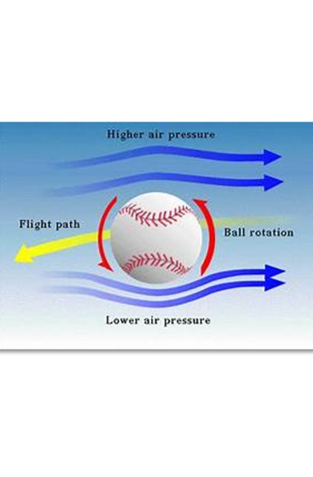
Play Narration
A model is a simplified version of a complex problem.
A simple analogy of a model is the motion of a baseball which is quite complex.
10
Notes:
Models attempt to simplify a complex physical system for the purpose of simulating reality and making predictions.
If, for example, we attempt to analyze the motion of a baseball thrown through the atmosphere, we find it quite complicated. The force that propels it varies. The ball is neither spherical nor perfectly rigid. It has raised seams and spins as it moves through the air. Wind and air resistance influence its motion. Not only does the baseball rotate, but the Earth beneath it also rotates. The ball’s weight varies as its distance from the Earth’s center changes. All of these factors affect its motion, path, and final destination. If we try to include all these small details, our analysis becomes quite tangled.
Click the Next button below to continue.

Slide 11
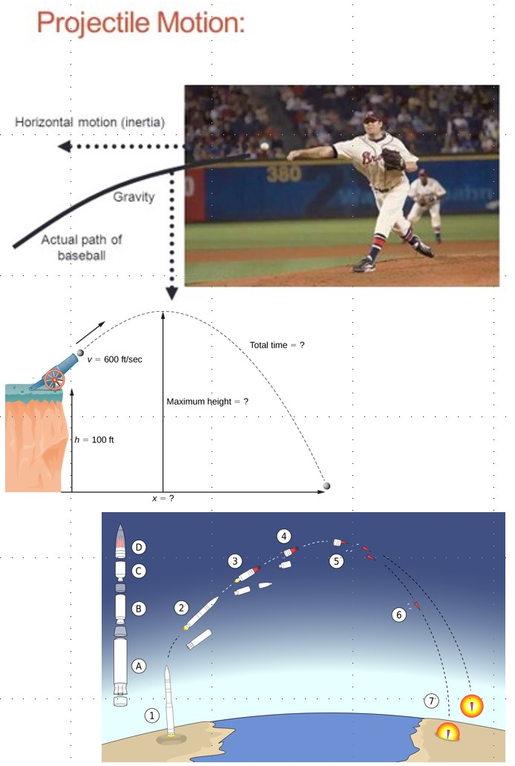
How and why do Models work?
Play Narration
Models simplify complex systems to simulate or predict reality. They help to understand and analyze intricate phenomena by breaking them down into manageable components.
Models can be based on:
Mathematics (Equations)
Statistics (Probability)
Physical (Replication or Duplication)
Computational (Simulation)
Hybrids (Combination of the above)
11
Notes:
Instead, we invent a simplified version of the problem. We break it down into manageable components. We neglect the size and shape of the ball, representing it as a point. We neglect air resistance and make the ball move in a vacuum. We also ignore the Earth's rotation and assume the weight is exactly constant. Mathematically, the ball is, in essence, a particle moving along a parabolic path. In effect, simplicity emerges from complexity. The simplifications are used to get us in the ballpark. In fact, the same simplification enables us to deliver artillery shells and nuclear warheads with acceptable accuracy.
In a similar manner, simulations like FDS, based on models, can produce both data and graphical representations that effectively convey technical information that assists in understanding how a fire may have evolved, and assess the relationship between the heat release rate of the burning fuel and other variables (e.g., fire spread and property damage, tenability, etc.)
Models can be simple or complex, depending on the system being represented and the degree of accuracy required. The Fire Triangle is a simple model that explains the necessary ingredients of most fires and graphically illustrates the three criteria required for a fire. That is fuel, heat, and an oxidant, typically atmospheric oxygen. The Fire Triangle has further evolved into the Fire Tetrahedron, based on research that has expanded our understanding of the principles of fire science and fire dynamics.
Effectively, fire models are a way of playing with fire without getting burned and at a much-reduced cost. Instead of constructing a physical model of the structure, equipping it with sensors, and video recording the process and its outcome, we build a duplicate of it on a computer, equip it with virtual sensors, run the simulation, and record the results.
Click the Next button below to continue.

Slide 12
Uses of Modeling for Fire Investigation
Play Narration
Understanding the fire.
Timeline Analysis
Survivability Analysis
Analyzing Post-Fire Indicators
Visualization of Fire Phenomena
Multiple Hypotheses
12
Notes:
While computational models like Fire Dynamics Simulator which is a simulation, can be used to test hypotheses, they should not be used as the sole basis for determining fire origin and cause. This limitation is reflected in the current edition of NFPA 921. Tools like FDS based on Computational Fluid Dynamics) break their computational domains into a mesh of smaller volumes that take into account many fundamental laws of basic fire science and fire dynamics and can solve problems to a greater detail than many traditional models based on equations. Additionally, they can spatially and temporally display quantitative data predicted by their simulations. The investigator can then use this information to evaluate potential fire scenarios.
Even if a fire investigator never uses simulation, there is an ever-increasing probability that their opinions or conclusions will eventually be tested against a formal Fire Dynamics Analysis based on a simulation. Simpler models, based either on equations or groups of equations coupled together as a procedure, simply cannot collectively consider all the variables that affect the development, growth, or impact of a fire on either the structure or the occupants.
An article entitled COMPUTER FIRE MODELS FOR FIRE INVESTIGATION AND RECONSTRUCTION, authored by Gregory E. Gorbett of Eastern Kentucky, focuses on the use of computer fire models for fire investigation purposes and provides a detailed discussion on the input data needed for fire modeling, available education and training, and its application in analyzing fire dynamics.
Specifically, the use of computer fire models in validating or refuting an origin hypothesis by comparison of fire patterns was studied. The book further explains how fire models are categorized as equations that are hand-calculated, grouped into procedures and collectively calculated, physical models, or mathematical models, which can be either zone or field models and are based on computational fluid dynamics (CFD).
It explores how computer fire models are used to design and analyze fire protection systems, evaluate the effects of fire on people and property, estimate fire risks, and assess post-fire reconstruction. It also provides a detailed discussion on the input data needed for fire modeling, the application of these models in analyzing fire dynamics, and using computer fire models to validate or refute origin hypotheses by comparing fire patterns.
Click the Next button below to continue.

Slide 13
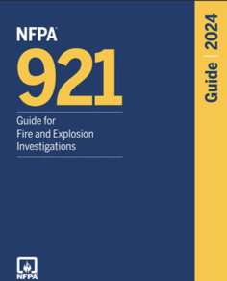
Play Narration
NFPA 921 recommendations for Mathematical Modeling
Chapter 21 of the current edition of NFPA 921 addresses the acceptance and limitations of mathematical fire models, of which FDS is based.
Essentially, those guidelines suggest that while modeling can be used as a tool to test hypotheses, due to its limitations, it should not be used as the sole basis for determining the origin and cause of a fire.
Further, NFPA 921 recommends that the results of all models be assessed through the use of a Sensitivity Analysis and that all input and output files be retained in their original form as part of the investigative record.
13
Notes:
The term "mathematical modeling" first appeared in the 2011 edition of NFPA 921, the "Guide for Fire and Explosion Investigations." The edition features a discussion on the application of mathematical models in fire investigations, highlighting their significance in analyzing fire dynamics and validating hypotheses.
While not specifically mentioning FDS, NFPA 921 states that mathematical modeling techniques provide an investigator with tools for testing hypotheses regarding the origin and cause of the fire/explosion and the cause of the resulting damage to property or injury to people.
NFPA 921 further states that Mathematical modeling, whether simplified hand calculations or computer fire models, has inherent limitations and assumptions that should be considered. Models generally rely on empirical data and are validated via comparison with other empirical data. Care must be taken to ensure that the model is being used with due regard for limitations, assumptions, and validation. While computational models can be used to test hypotheses, models should not be utilized as the sole basis of a fire origin and cause determination.
NFPA 921 further explains that Inputs to mathematical models are subject to uncertainties that should be considered in evaluating model results and that the effects of input uncertainties should be assessed through the use of sensitivity analysis.
The guide further recommends that Input files and output files from a computer model should be retained in their original form as part of the investigative record. When input and output files are provided to other parties, they should be submitted electronically in their original form, allowing for examination. Files should not be provided in the form of scans or facsimiles, as this limits the ability to use or examine the results via the software. As with all discovery issues, parties are free to litigate the reasonableness of the scope of discovery, cost sharing, the burden of production, and the protection of proprietary or trade secrets. Courts can fashion remedies that accommodate and protect the interests of all parties.
Lastly, using FDS to perform a formal Fire Dynamics Analysis not only narrows the universe of possible solutions but also compels the investigator to base their conclusions on facts and evidence rather than experience, demonstrates adherence to the Scientific Method rather than simply claiming to have done so, and provides transparency and a way that others can reasonably examine and duplicate for verification and accuracy.
Click the Next button below to continue.

Slide 14

Play Narration
What is Fire Dynamics Simulator (FDS)
If used properly with regard to its limitations FDS can provide valuable data on the performance of buildings and materials under fire conditions.
It can also be used to test hypotheses arising from fire investigations and to recreate fire scenarios for research and training purposes.
FDS, and other digital or computer simulations cannot replace a fire investigation analysis or actual physical modeling.
14
14
Notes:
Fire Dynamics Simulator (FDS) is a computational fluid dynamics (CFD) model developed by the National Institute of Standards and Technology (NIST) in the late 1990s. The core of FDS is based on the solution of the Navier-Stokes equations , or differential equations, which describe the motion of fluid based on Computational Fluid Dynamics. These equations are coupled with additional equations that model the heat transfer, the combustion process, and the production and spread of smoke and fire. FDS is commonly used to simulate the spread of smoke and fire, evaluate the performance of fire protection systems, analyze the safety of building designs, and investigate fires.
FDS is open-source software, which means it is freely available and can be modified by users to suit their specific needs. Its low cost to users also contributes to its misuse or application beyond its limitations, as there are better tools available at a lower cost. Simulation is also used in fire investigation because it is less expensive and safer than creating an actual physical model.
FDS, however, has limitations. The accuracy of the simulation results depends on the quality of the input data and the resolution of the computational grid. High-resolution simulations require significant computational resources and can take a long time to complete. Digital or computer fire models, while highly advanced and useful, cannot completely replace actual physical models for several reasons:
Complexity and Accuracy: Physical fire models can capture the full complexity of fire behavior, including unpredictable factors and interactions that may not be fully accounted for in digital models. Real-world conditions often involve variables that are difficult to simulate accurately.
Validation and Calibration – Computer models need to be validated against physical experiments to ensure their accuracy. These insights are crucial for improving the accuracy and comprehension of fire simulations.
Physical models can reveal unforeseen variables and behaviors that might not be included in digital models. These insights are crucial for improving the accuracy and comprehensiveness of fire simulations.
Digital models rely on accurate input data, which can sometimes be incomplete or imprecise. Physical models provide a more direct observation of fire behavior, reducing the reliance on potentially flawed input data.
Many regulatory and safety standards still require physical testing to ensure compliance and safety. Physical models provide a tangible way to meet these requirements.
Physical models do offer valuable hands-on experience that can provide visual understanding and can also be crucial for training and education.
Click the Next button below to continue.

Slide 15
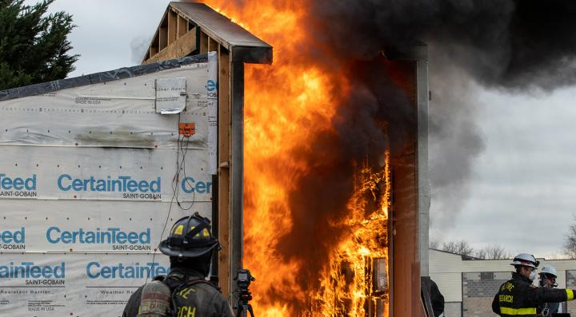

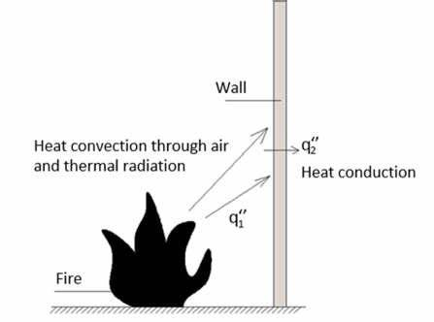
Play Narration
FDS Incorporates several sub-models.
Combustion Model
Radiation Model
Turbulence Model
Heat Transfer Model
Smoke and Soot Model
Ventilation Model
An example of
radiation from a
fire in the real
world.
In the real world, radiation is emitted in an infinite number of angles in three dimensions. Instead, FDS simplifies this using (by default) approximately 100 discrete angles
15
Notes:
FDS incorporates several sub-models, each of which is simplified but coupled together to provide a comprehensive simulation of the fire dynamics.
A combustion sub-model simulates the chemical reactions of burning materials, including the production of heat and combustion products such as smoke and gases.
Another sub-model, the radiation sub-model, simulates heat transfer through radiation, which is crucial for understanding how fires spread and affect their surroundings.
Fire investigators recognize that one of the fundamental mechanisms of heat transfer in all fires is radiation, which becomes the primary means of heat transfer as the fire progresses. The radiation sub-model of FDS is designed to simulate the transfer of heat through radiation, a critical aspect of fire dynamics.
However, modeling this would require an infinite amount of resources and time because, in the real world, radiation is emitted in an infinite number of angles in every direction. Instead, FDS simplifies this (by default) using approximately 100 discrete angles, which requires approximately 20% of the total CPU time of a calculation —a modest cost, given the complexity of radiation heat transfer. This simplification allows a solution that is reasonably accurate within an acceptable time limit.
A turbulence sub-model simulates the chaotic and irregular flow of air and gases, which is crucial for accurately modeling the behavior of smoke and heat.
A heat transfer model encompasses conduction, convection, and radiation to simulate the transfer of heat through various materials and spaces.
A smoke and soot sub-model models the production and movement of smoke and soot particles, which are critical for visibility and toxicity assessments.
In Fire Dynamics Simulator (FDS), the value of soot is defined through several parameters that characterize its behavior and impact on fire dynamics. These parameters include. Soot yield, which represents the amount of soot produced per unit mass of fuel burned. It is a crucial parameter for determining the concentration of soot in the fire environment and is related to the visibility that occupants experience during a fire. Soot yield is important for accurately predicting the behavior of soot in fire scenarios, including its effects on visibility, smoke alarm activation, and surface deposition. FDS typically sets the default soot yield to 0.01, which means that 1% of the fuel mass is converted to soot. This value can be adjusted based on the specific characteristics of the fuel and the fire scenario being modeled.
Lastly, a ventilation sub-model simulates the effects of ventilation systems on fire and smoke behavior, including the impact of fans, vents, and other airflow mechanisms.
Click the Next button below to continue.

Slide 16
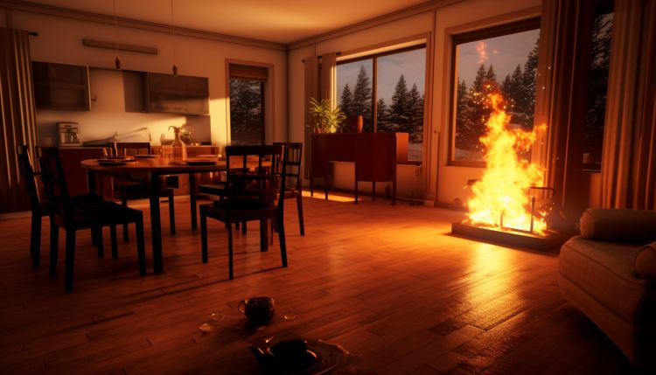
Steps in applying FDS to create a Simulation
Play Narration
Construct the simulation.
Run the simulation.
3. Analyze and interpret the results.
.
16
Notes:
There are three major steps in using FDS in fire investigations.
Step 1, the first step is to Construct the Simulation -The construction of the simulation involves gathering necessary information and data to build a model, define its structure, contents, and fire, and assign its thermo-physical properties. Geometric data may be derived from the investigation, witness statements, and construction records. Material data may be drawn from various sources or testing of exemplar material. Standard fire curves can be used to define the heat release rate over time or based on material data entered into the input, which the model then predicts.
Step 2 The second step is to run the simulation. When FDS is run, it solves equations that describe the fire's evolution and its impact on the computational domain of the simulation. Virtual devices are defined by the user to monitor, measure, and record the fire development and to analyze and interpret its results.
Step 3, the final step, is to analyze and interpret the simulation results. - FDS’s output is saved as files that are evaluated either in the form of data or displayed graphically. The user can monitor the model’s progress and make corrections to any errors. The simulation predicts the time-dependent concentrations of fire effluents and the thermal environment of the fire.
By meticulously following these steps, you can ensure that your fire dynamics simulation is both effective and meaningful. Each step ensures that the simulation is set up correctly, which is essential for obtaining accurate and reliable results. Skipping or incorrectly performing a step can lead to errors or misleading data. Properly defining the computational domain, fire properties, and material characteristics enables the creation of a realistic simulation that closely mimics real-world fire scenarios. This realism is vital for verifying the simulation is consistent with basic fire science and fire dynamics.
Setting up the grid and running the simulation efficiently can save computational resources and time. Properly configuring the simulation can prevent unnecessary reruns and adjustments. Visualization is crucial for determining whether the simulation’s predicted outcome aligns with witness testimony and the level of certainty associated with conflicting expert hypotheses. Accurate simulations can inform fire safety strategies, building designs, and emergency response plans. By understanding how fires behave in various scenarios, more effective preventive measures and responses can be developed. Following these steps ensures that the simulation adheres to industry standards and guidelines, which is important for regulatory compliance and professional credibility.
Click the Next button below to continue.

Slide 17



Play Narration
Constructing the FDS Model
Gather Information and Data
Define Thermophysical Characteristics
Heat Release Rate Definition
Construct the geometry of the structure and its contents, define the location of the fire, and specify the thermophysical characteristics of the structure and its contents.
Specify a standardized T2 fire curve or allow the model to calculate and predict the fire growth rate based on the input data.
Obtain material properties from databases, conduct cone calorimeter testing, or average values from various sources.
The process of constructing the model is crucial for accurate fire simulation. A model’s input is important because its input determines its output. (GIGO – Garbage In…..Garbage Out)
17
17
Notes:
FDS writes to and continually saves numerous files while running a simulation. Many of these files cannot be opened or understood by the average fire investigator. However, a single input file with a suffix (.FDS) used to create the simulation is the most important, as it contains all the assumptions a fire investigator needs to evaluate to determine whether they are consistent with the facts and evidence of a specific incident. Unlike many other files, the input file is written in plain English (ASCII) and can be opened using readily available software (e.g., Notepad, WordPad), making it understandable to the average fire investigator. This file is often unavailable to a fire investigator or other expert evaluating the matter, yet it is necessary to verify its content and duplicate its results. To complicate the issue, the file often lacks comments, which can aid in understanding the simulation’s logic.
Adding comments within the code helps others understand its construction. Such comments, although not required, facilitate understanding and analysis of the model’s input and logic, as well as verification and duplication of its output. Adjusters and attorneys sometimes fail to recognize the significance of this single input file, which an independent evaluator can use to identify and determine where the correct values were applied to reach the results or conclusions the simulation purports to achieve. For this reason, model users either fail to comment on the code or sometimes produce only the simulation results and their interpretation, hiding, withholding, or failing to produce this file unless specifically asked to do so during litigation. Those who either forget or do not know to ask never see it.
The input file, if obtained, can be used to rerun the simulation and examine the facts, basic fire science, and fire dynamics, thereby determining the level of certainty regarding competing hypotheses. It can be used to duplicate the simulation. Duplication is one of the foundations of science. However, duplication alone does not guarantee accuracy; it must also involve an error rate in order to define the level of certainty. It is for this reason that NFPA 921 requires a hypothesis to be “probable” for an investigator to express an expert opinion with reasonable certainty. Civil courts require this same level of proof for a matter to prevail.
In science, absolute certainty is rarely achieved because scientific knowledge is always evolving with new evidence and discoveries. Instead, scientists often discuss the degree of confidence or probability that a particular finding or theory is likely to be correct. Because cognitive assumptions can distort the interpretation of observations, scientists rely on empirical evidence and critical thinking. In legal contexts, you may hear terms such as "reasonable scientific certainty" or "reasonable degree of scientific certainty." However, these phrases don't have a precise scientific meaning, can sometimes be confusing, and are often used to convey that an expert's opinion is based on a high level of confidence but not absolute certainty.
NFPA 921 requires a hypothesis to be “probable” for an investigator to express an expert opinion with reasonable certainty. Civil courts require this same level of proof for a matter to prevail. Because of the greater risk (e.g., loss of freedom or life), criminal courts require proof beyond a reasonable doubt, recognizing that absolute certainty can never be achieved. Instead, risk (or the responsibility for it) is spread over more than one person or the vote of a jury.
Click the Next button below to continue.

Slide 18
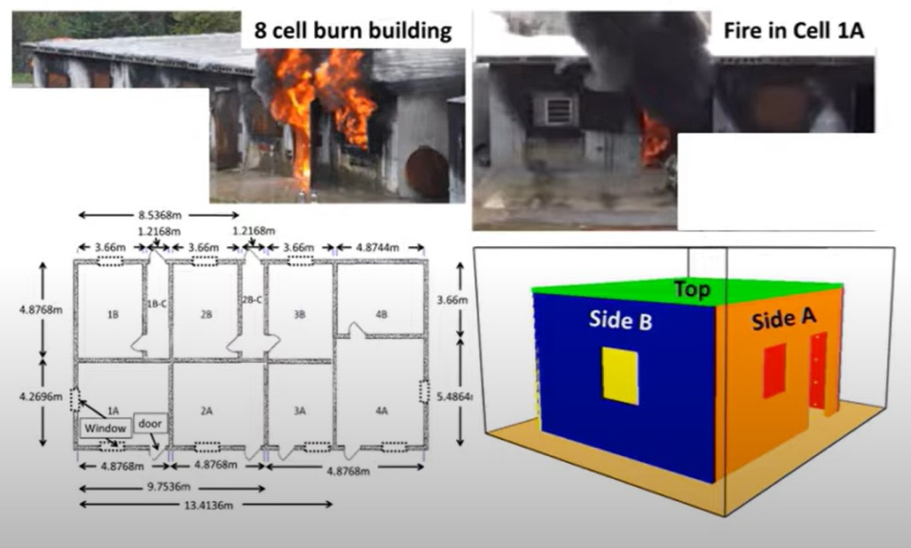
Play Narration
What is needed for FDS input
Because computer fire modeling use is steadily increasing in use for fire investigations and analysis the need for input data for fire models has increased.
Typically, fire investigators at the time of performing an on-scene investigation do not realize that a computer fire model will assist at a later point.
Therefore, every on-scene investigation should require investigators obtain the data required for modeling.
18
Notes:
The fire investigator does not need to understand the equations on which FDS is based, although it is helpful. They must, however, be trained in its use, understand and apply it within its limitations, and possess and apply the knowledge, training, experience, and methodology as described or required in both NFPA 921 - Guide for Fire & Explosion Investigations and NFPA 1033 - Standard for Professional Qualifications for Fire Investigator to analyze and interpret its output.
At a minimum, the investigator must have a solid understanding of fire behavior, heat transfer, fluid dynamics, and combustion processes, as well as familiarity with the FDS users’ guide and tutorials, to understand how to set up and run simulations. Basic knowledge of scripting languages (e.g., FORTRAN, Python) can be helpful, although not required, for automating tasks, processing results, and data interpretation, which enables the analysis and interpretation of results, including temperature distributions, smoke movement, and heat flux.
Many scene exam diagrams that are prepared during the initial origin and cause investigation of a fire scene are floorplans in two dimensions, and field notes do not contain sufficient data to reconstruct either the computational domain or identify the thermo-physical characteristics of the fuels involved (e.g., structure or contents) needed for input to FDS.
The structural dimensions or geometry of the building are an important aspect of recreating a scenario in computer fire models. Additionally, the investigator needs to obtain the locations of furniture and other fuel packages, as well as the thicknesses and heights of those pieces of furniture
In enclosure fire dynamics, the materials lining the walls, ceiling, and floor play an important role in the transferring of energy out of the compartment. It is recommended that investigators collect and preserve samples of these lining materials. The thermal and physical properties of these materials must be determined through testing or research.
One of the most important variables input into a computer fire model are the types of fuels and their properties. The user of the model will need to input the heat release rate per unit area of the primary and secondary fuels. Additionally, the computer model will require a fire growth rate (HRR over time) to be input. Therefore, the more information regarding the type of fuel, the properties of fuel, size, orientation, and location within the compartment, the less error involved in implementing this variable into the computer fire model.
Additionally, it is recommended that investigators collect and preserve samples of the fuels for further analysis. The location, size, and characteristics of the fire or heat source being modeled.
The investigator will need to locate and document all of the ventilation openings, including their heights and widths, soffit, and sill. These include windows, doorways, HVAC, and other mechanical ventilation issues (PPV)
The investigator will need to locate all fire protection elements on their diagram, including their heights. One of the biggest problems with fire protection elements is the inaccurate placement of these devices, especially smoke alarms.
Investigators will also need to determine if and when changes occurred during the progression of the fire, as well as what these changes were. This may become very important if changes to the ventilation were done during the progression of the fire. This can oftentimes be obtained through witness interviews and physical evidence.
The investigator needs to perform a photographic survey of the scene to capture other elements that may not be preserved on the scene diagram. Additionally, the photographs will become paramount in analyzing the post-fire indicators.
Click the Next button below to continue.

Slide 19
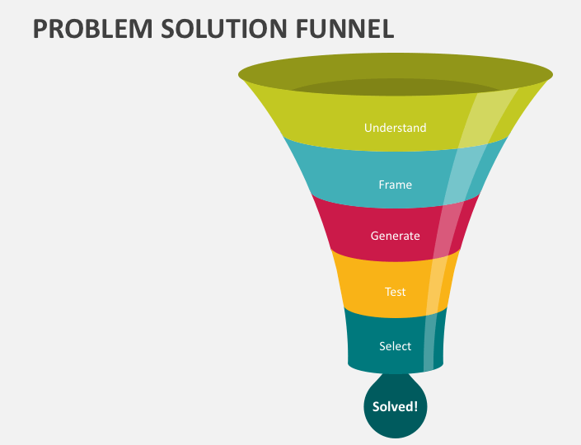

Play Narration
Running FDS
FDS is written in FORTRAN.
The input file is small
And that creates the simulation is
written in ASCII and easily opened and read with a text file editor. Computational requirements may vary depending on the complexity
of the simulation
19
19
Notes:
The results of the simulation can be viewed in real time while the simulation is running or recreated later from files saved during its execution. Depending on its complexity, the simulation may run for several seconds, minutes, hours, or days. The resources needed to run a simulation may be available on a typical laptop or may require multiple computers that are run in the cloud over the internet.
The length of most simulations is between 3-30 minutes or 180-1800 seconds. Many crucial factors in fire occur in its early development.
Because of NFPA 921’s requirement for a Sensitivity Analysis, most simulations are run multiple times, starting out simple and becoming more complex with later runs as the user constructs the simulation. As the simulation is rerun, errors are discovered and corrections are made. The user of FDS may not save or produce these or earlier files, and the final input file may not be commented with observations that explain the simulation logic.
FDS utilizes a Command-Line Interface or CLI to generate the input file used to conduct a simulation. The input file duplicates the location where the fire occurred and creates the Computation Domain that FDS uses to simulate the scene, including the building, its contents, and the surrounding area. The same software can be used to run the simulation and as a post-processor to analyze and interpret its results. FDS may also be created, run, and interpreted with Third Party software utilizing a (Graphical User Interface) that is quicker and easier to learn and use.
The input file is part of the documented chain of evidence crucial for ensuring that the simulation can be trusted to accurately represent the facts of the case..
FDS is run in the FORTRAN programming language, with the input parameters provided in a single ASCII text file with a suffix “ .fds. “ FORTRAN (short for "Formula Translation") is one of the oldest high-level programming languages, designed primarily for scientific and engineering applications. It was developed in the 1950s by IBM and has undergone several revisions to improve its capabilities and performance. FORTRAN was created to facilitate numerical computation and scientific computing. It is particularly well-suited for tasks involving complex mathematical calculations and data processing.
Click the Next button below to continue.

Slide 20
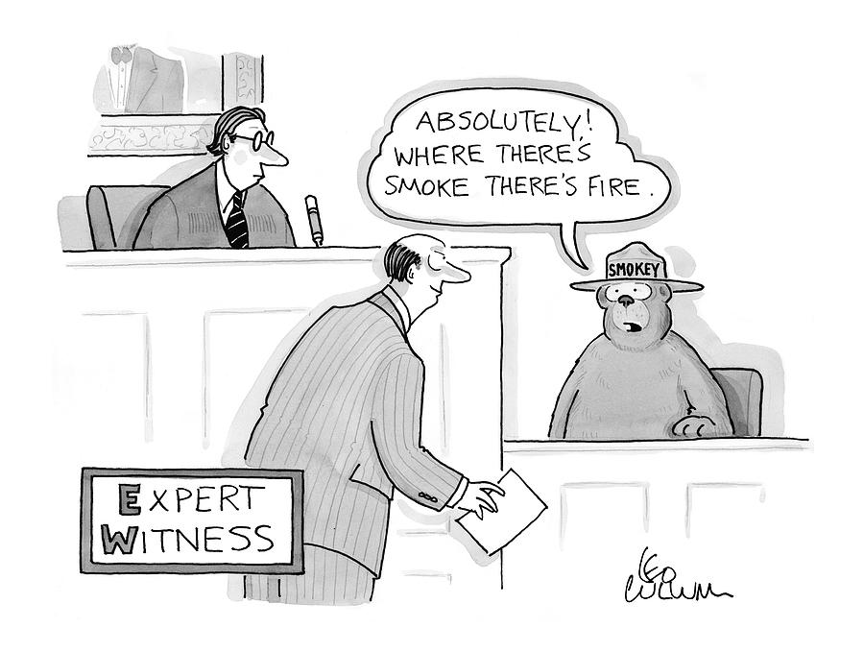



Play Narration
Interpreting FDS Results
The purpose of a simulation and of expert testimony:
Simplify or clarify complex concepts,
Evaluate data
Present scientific evidence
Assist in decision making
.
20
20
Notes:
A simulation and expert testimony both provide specialized knowledge and insights that help the court understand complex issues and make informed decisions. The purpose of both is to simplify or clarify complex concepts, evaluate data, present scientific evidence, and assist in decision-making. In addition to training in the use of FDS and the interpretation of its output, using FDS requires experience, training, and knowledge of fire investigation, basic fire science and dynamics, and fire dynamics analysis, as described in both NFPA 921 and NFPA 1033, not just the FDS software or its application.
By interpreting the simulation's output and visualizing its results, valuable insights into the fire's progression and impact can be gained. Time-dependent concentrations of fire effluents and the thermal environment of the fire can be determined from the model's output and can be compared against benchmark events and tenability criteria to assess the fire's development and the occupants' ability to escape.
The user can monitor and view the simulation's progress in real-time without interrupting it, and, if needed, make corrections to errors that may not have been obvious during its construction.
The program will check for errors when it opens the file to run the model and will fail to run if any errors are detected. Syntax refers to the set of rules and principles that govern the structure of sentences in a language. It dictates how words and phrases are arranged to create meaningful sentences. Syntax is a fundamental aspect of any programming language, and the structure of the input file and its specific syntax must comply with the requirements of the version of FDS software being used.
The most common errors in FDS are due to mistyped input statements that, when run, result in the immediate halting of the program. Newly released versions of FDS often drop or change parameters, forcing you to re-examine and revise old input files. Because the software evolves and changes, if involved in later litigation, not only must the output files of the simulation be saved, but also the version of software used to create it must be available.
Click the Next button below to continue.

Slide 21
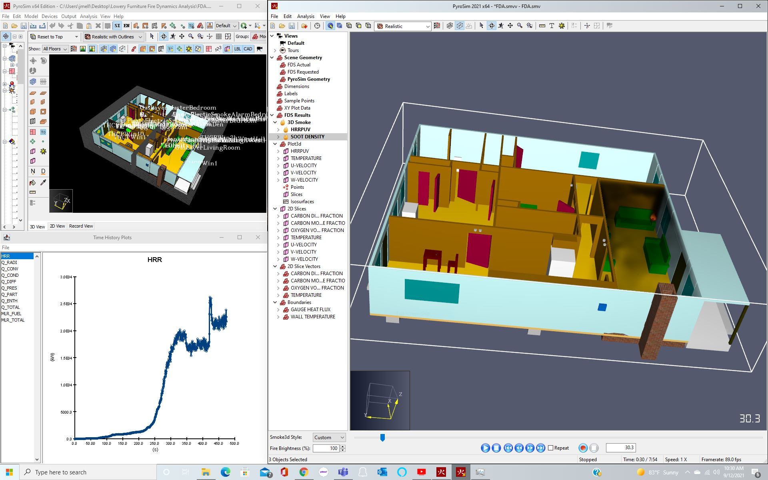
Play Narration
Interpreting FDS Results
The graphic shown at the right is a snapshot of the smoke and fire predicted by FDS 30.3 seconds into the simulation.
The entire simulation may be viewed in real-time (as a video) and the data in its output files extracted, evaluated, and shown in 3rd Party software programs (EXCEL.)
21
21
Notes:
The graphic being shown is a snapshot of the smoke and fire predicted by FDS 30.3 seconds into a simulation. The following facts serve as the basis to unravel the process of using FDS to simulate a fire and illustrate one of the many ways in which FDS can be used to predict the potential impact of a fire on both the residence and its occupants. The fire occurred in the early morning hours and resulted in the deaths of two of the four occupants inside the residence.
A young mother and her small daughter were asleep in a hallway bedroom and awakened by her 8-year-old son, who reported a fire. The mother went down the hall to investigate and observed a small fire on the arm of a sofa in the living room in the front of the residence. She returned to her bedroom, retrieved her daughter, and exited through the dining room at the rear of the house near the master bedroom. Once outside with her child, the mother attempted to break the back window of the bedroom before going next door to a neighbor who called 911 and reported the fire. Arriving firefighters began fire ground and search and rescue activities and found the young boy with his grandmother inside the master bedroom.
Both perished in the fire. Autopsy reports on both victims revealed the cause of death as thermal injury and smoke inhalation and the manner of death as undetermined.
Often, the opinions of a trained medical examiner are a valuable tool but are of limited value in explaining why an occupant did not survive the fire and instead perished. The answer to this and related questions requires a broader knowledge of the building, the fire, and the individual, including the location, movement, and actions of the occupant during the fire, the tenability conditions that existed before and throughout the fire’s development, and the collective impact of those conditions on the occupant.
The manner of death or underlying circumstances that place in motion a physiological process culminating in the person’s death, as natural, accident, homicide, is typically undetermined, pending, while awaiting the findings of the fire investigator.
The fire investigator should understand that cause of death findings are the opinions of a trained physician regarding the medical reason(s) for a person’s death. The cause of death in many fires is frequently listed in the Medical Examiner’s report as smoke inhalation accompanied by a significant elevation in postmortem carboxyhemoglobin (COHb). A medical examiner's findings, however, may provide valuable insight into whether an individual was alive during the fire or suffered from an impairment such as age, intoxication, drugs, or pre-existing handicaps unrelated to the fire itself.
The Manner of death, however, is usually determined by the findings of the fire investigator regarding whether the fire was accidental or intentional. This may or may not be completed when the autopsy is done.
Click the Next button below to continue.

Slide 22
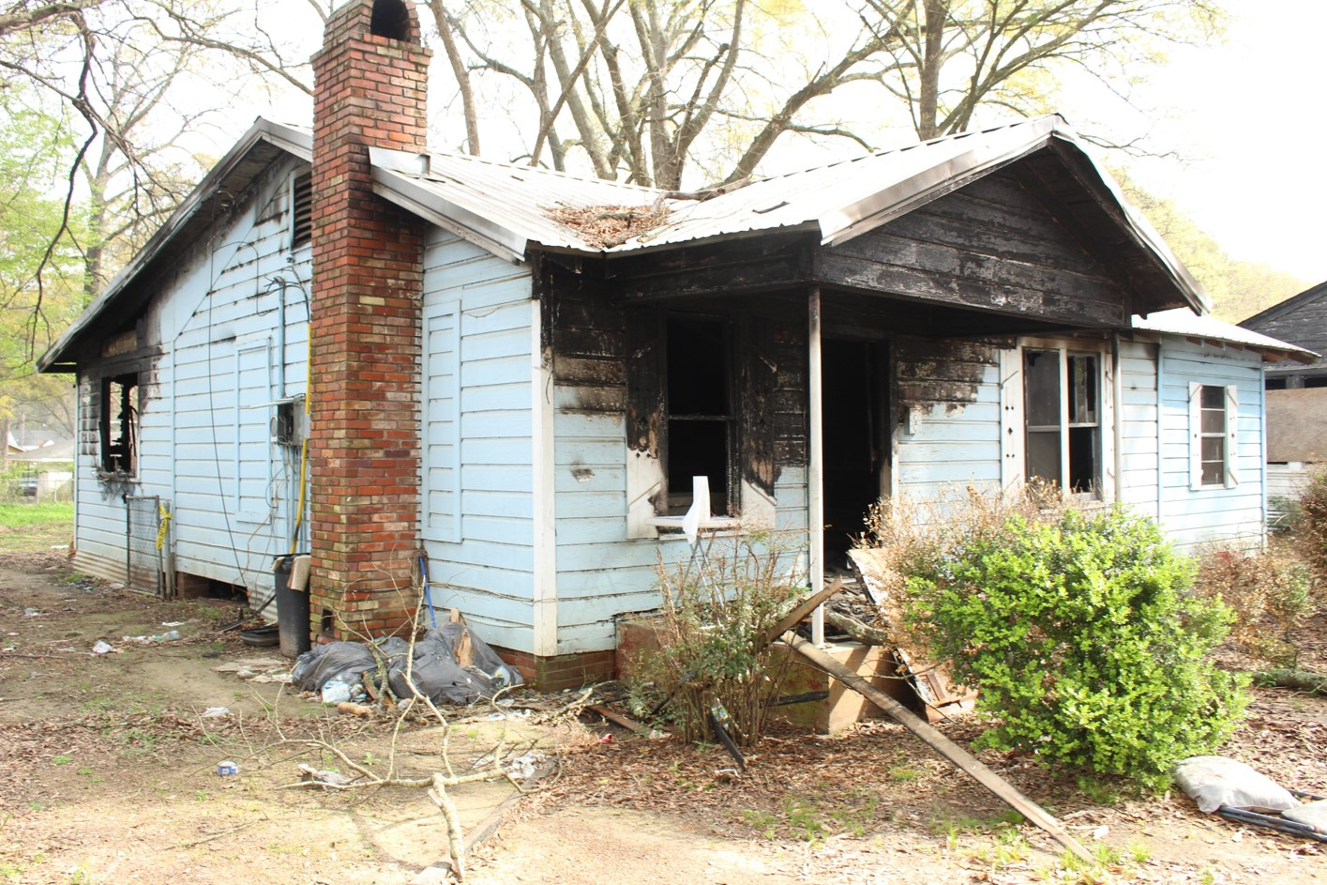
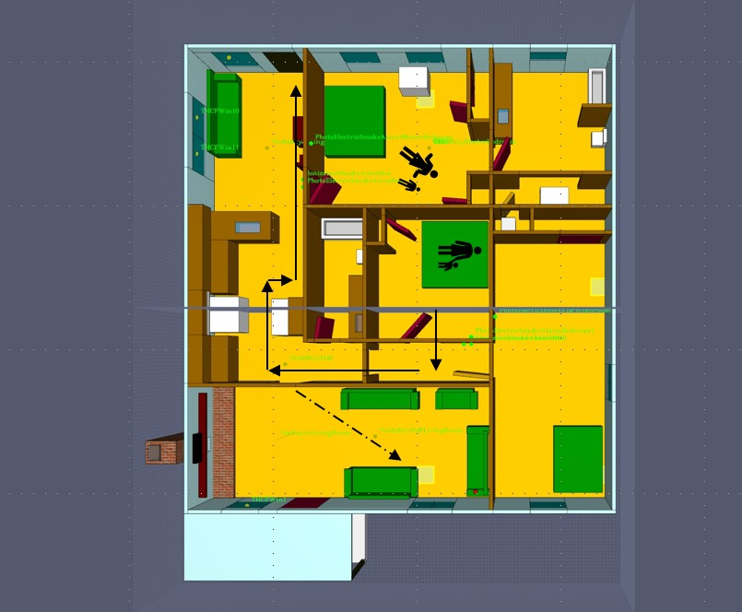
Play Narration
Actual Building before and after Simulation
Side A (Front Side)
22
22
Notes:
The graphics at the right show both the actual damage to the residence after the fire and what the Computational Domain would look like after being constructed in FDS. The Computation Domain duplicates the geometry of the structure being simulated. The input file for an FDS simulation creates the Computational Domain and duplicates the structure (geometry), the fire scenario, and the conditions that existed at the time of the fire. The input file used to create the simulation is based on the deposition testimony of witnesses who survived the fire, investigation by public and private fire investigators, and confirmation of the structure, its contents, the cause of death of its occupants by a Medical Examiner, and confirmation and additional research by the simulation’s developer.
The original location of the mother and small child is shown inside the hall bedroom, the path that was taken to exit the structure (i.e. egress), the sight path (when the fire was first seen), and the location of the grandmother and small boy inside the master bedroom where they were late found by firefighters responding to the fire
Without access to FDS’s input file, the simulation cannot be recreated or duplicated, and the simulation’s results cannot be verified or validated. While duplication, or replication, is a fundamental aspect of scientific validation, helping ensure that results are reliable and not just a one-time occurrence, it does have some limitations. One limitation is the same data can produce the same result or solution. For example, a fire that originates in the same location may have the same output (e.g., solution), whether accidental or intentional.
The investigator can estimate the fire’s origin, growth rate, and other crucial factors using inverse modeling. The observed data may be used to infer the conditions or parameters that produced those observations (Inverse Modeling). Essentially, it's like running the simulation in reverse. You start with the output and work backward to determine the input parameters that led to that output. For example, although helpful in testing different or competing hypotheses.
Arguably, the input file is the most important file of the simulation. Without access to FDS’s input file, the simulation cannot be recreated or duplicated, and the simulation’s results cannot be verified or validated. FDS assigns it a suffix of .fds but it may be created, converted, or read by other 3rd. Party software (e.g. PyroSim)
Users who create simulations using FDS or evaluate its output would well remember that FDS, like most simulations, is Deterministic, which simply means that their output is determined by their input or if you put garbage in, you get garbage out.
For clarification, the original location of the mother and small child is shown inside the hall bedroom, the path that was taken to exit the structure (i.e. egress), the sight path (when the fire was first seen), and the location of the grandmother and small boy inside the master bedroom where they were found by firefighters responding to the grandmother was confined to bed at the time of the fire. Previous amputation of her left leg below the knee, less than a year before, required nursing assistance for normal activities (e.g., using the bathroom or getting in or out of bed).
The medical examiner’s report indicated the grandmother was using both prescription medication and nonprescription drugs (Marijuana) at the time of her death. The young boy who perished in the fire had a habit of staying up late at night, playing video games on the computer in the living room. The distance from the responding fire department was less than 3 miles.
Click the Next button below to continue.

Slide 23
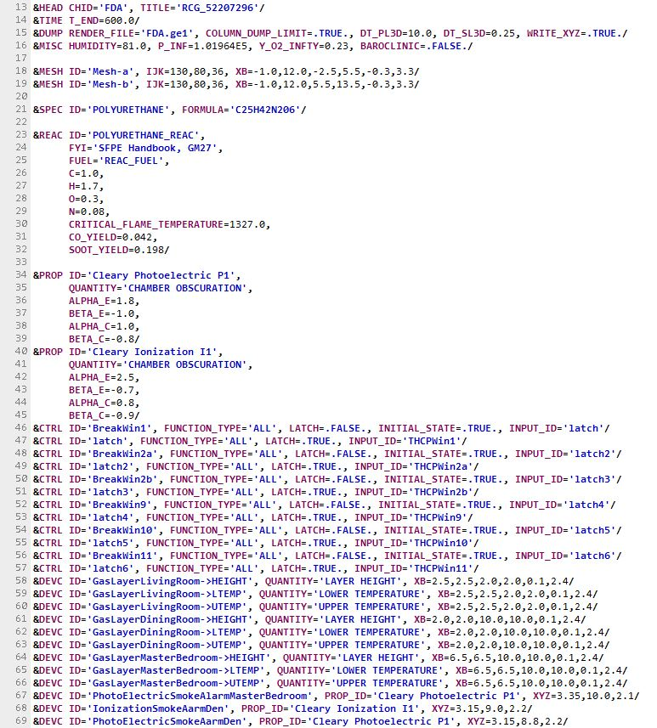
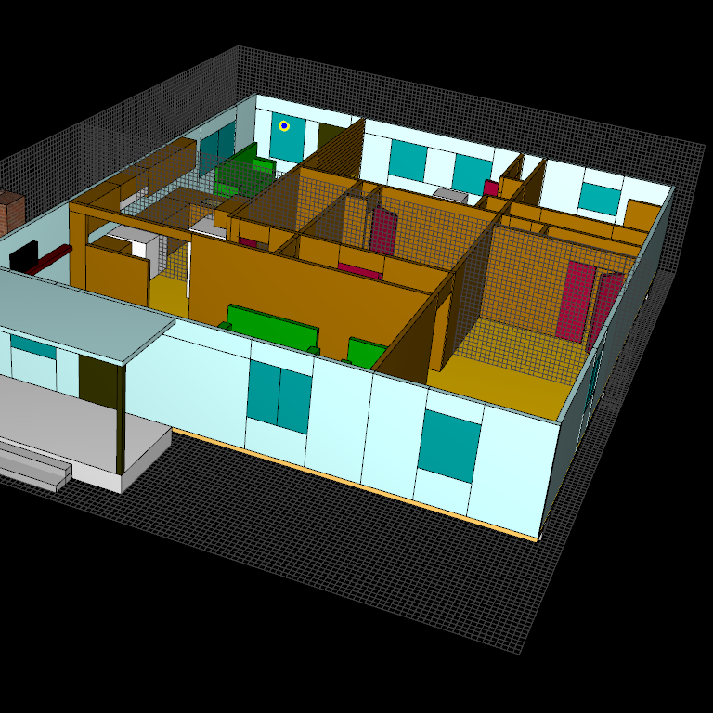
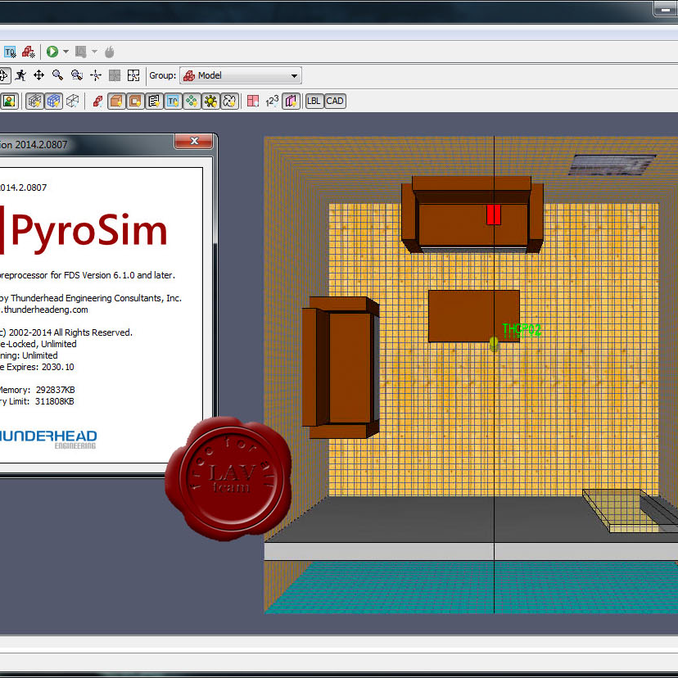
Constructing the FDS simulation.
Play Narration
Input file written in text form.
Computational Domain
3rd Party Pre & Post Processor
23
23
Notes:
The construction phase is typically labor-intensive and sometimes the most time-consuming part of the process. Constructing the simulation in FDS can be learned by studying and training in the FDS software, and it can be made easier by using third-party tools that utilize a Graphical User Interface instead of the Command Line Interface required by FDS. The data from an investigation is used to construct the geometry of the structure, its contents, and the surrounding area. Collectively, these are referred to as the Computation Domain, which comprises a mesh or group of cells within which computations are performed based on equations rooted in fire science, resulting in the predictions of the simulation. A higher level of expertise is required to understand the input values used to create the simulation, determine whether they are consistent with basic fire science and fire dynamics, and interpret the results in light of the facts of the fire being simulated.
Click the Next button below to continue.
.

Slide 24
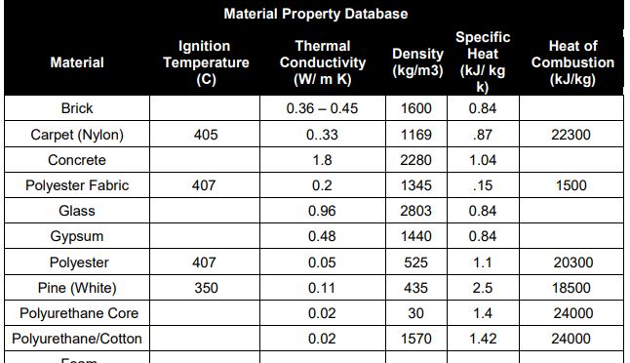
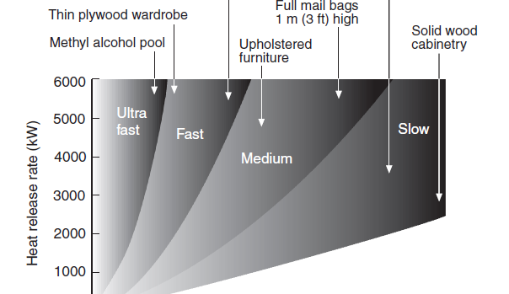
Describing the fire and the fuel
Play Narration
Governed by Material Properties
Governed Manually
24
24
Notes:
After creating the geometry, a source of ignition and its location are defined, and a fire scenario, or user-specified fire, is created by allowing the model to calculate heat release and fire growth. This is achieved by either entering the thermo-physical properties of the fuels involved or defining the fire based on a standard fire curve.
In Fire Dynamics Simulator, the heat release rate (HRR) of a fire can be governed either by the material properties or manually specified. Each approach has its own use cases and implications.
When the HRR is governed by material properties, it means that the heat release rate is determined based on the inherent characteristics of the material. This approach is more realistic and dynamic, as it considers how the material behaves under fire conditions.
Key factors that are included are:
Thermal Conductivity is the rate at which heat is conducted through a material.
Specific Heat Capacity, which is the amount of heat required to raise the material's temperature.
Density is the mass per unit volume of the material.
Heat of Combustion: The amount of heat released during combustion.
Lastly is the materials' pyrolysis or the rate and characteristics of thermal decomposition.
These properties may be obtained from existing databases of materials that have been tested and documented through cone calorimeter testing of similar materials. Differences in values of the same materials may be averaged. to both account for uncertainty and to frame the solution of the simulation. Testing of actual materials or exemplars collected from the scene can also be used.
Alternatively, a user can define a heat release rate over time, frequently based on a standardized T2 fire curve. (Slow, Medium, Fast).
In 1972, Heskestad first proposed that, for the early fire growth period, the assumption that fires grow according to a power-law relation is supported by experimental data. Later, it was shown that for most flaming fires (except those involving flammable liquids and certain other substances), there is a so-called t-squared growth rate.
When the HRR is governed manually, the user specifies the heat release rate directly in the FDS input file. This can be done using parameters like HRRPUA, or Heat Release Rate Per Unit Area, or total HRR. This approach allows for more control and simplicity, especially in scenarios where:
If the exact material properties are unknown or not critical.
A specific fire scenario must be modeled with a predefined Heat Release Rate (HRR).
Simplified or hypothetical fire scenarios are being simulated.
Governing the fire by material properties provides a more realistic and dynamic simulation as it reflects the actual behavior of materials under fire conditions. Manual specification is less realistic but offers more control.
Governing by material properties also requires detailed information about the material, making it more complex to set up. Manual specification is simpler and quicker. Manual specification enables easy adjustments and control over the HRR, which can be beneficial for testing various fire scenarios or conducting sensitivity analyses.
The concentration of oxygen has a direct impact on fire behavior. The oxidant involved in fire, usually atmospheric oxygen, provides the necessary reactant for combustion. At standard temperature and pressure and not enriched, normal air contains 20.95% oxygen. The minimum amount of free oxygen needed to support combustion varies with the thermophysical properties of the fuel.
The Fire Protection Handbook published by the Society of Fire Protection Engineers reveals that if flame retardants have not been added, hydrocarbon gases and vapors cease burning at oxygen concentrations below 13 percent, whereas charring solid fuels may burn with oxygen concentrations as low as 7 percent.
Click the Next button below to continue.

Slide 25
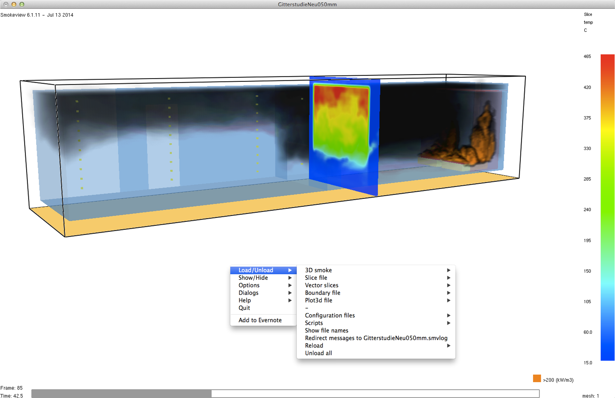
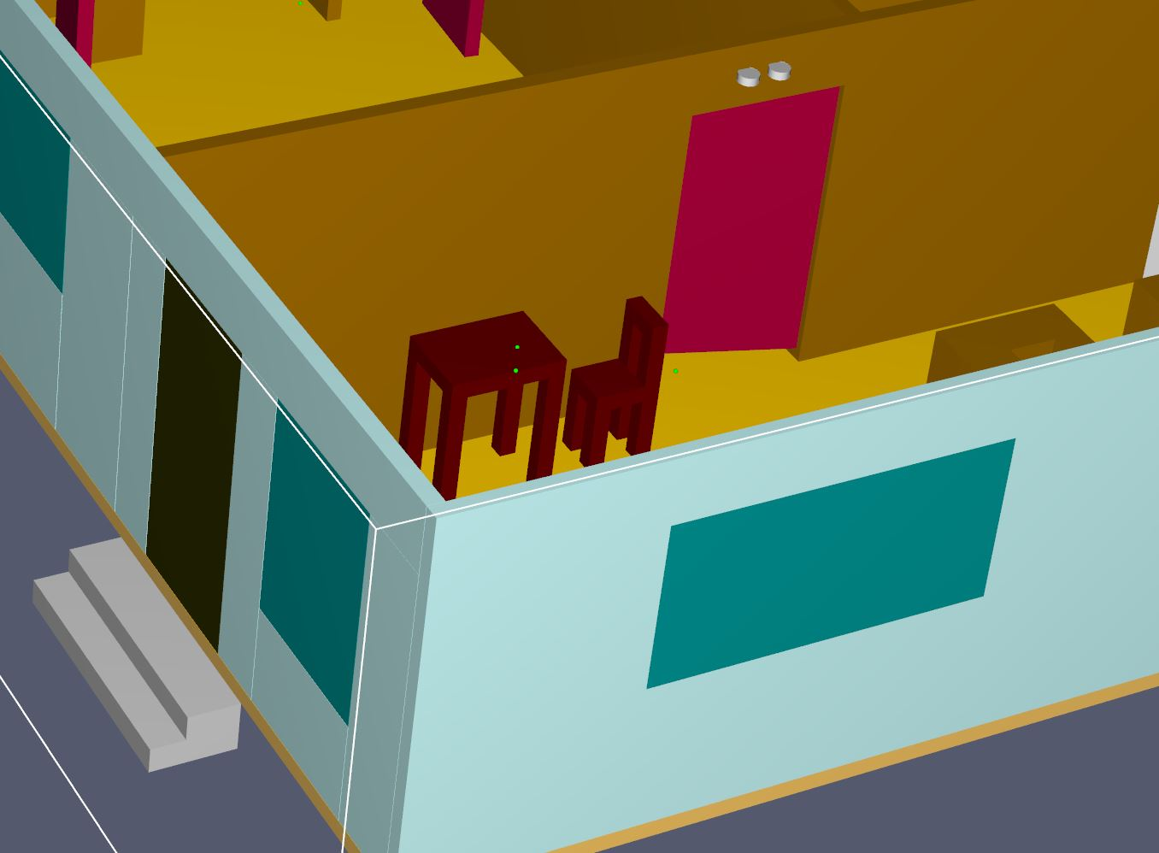
Measuring the development of the fire.
Play Narration
Slices and virtual devices are powerful tools in FDS for capturing detailed information about the fire environment as well as displaying data in a visual way.
25
25
Notes:
The last step in the construction of the model is to add slices, in two dimensions, or volumes in three dimensions, to capture changes in the fire environment over the course of time as the fire moves from ignition through extinguishment and are used to measure and may visualize various aspects of the fire’s development.
Fire Dynamics Simulator (FDS) can track and measure a variety of parameters related to fire dynamics and smoke transport. FDS can measure and predict soot, visibility, heat flux, temperature, pressure, velocity, Oxygen, Carbon Monoxide, Carbon Dioxide, hydrogen cyanide, fractional equivalent dose, smoke alarm activation, and water sprinkler activation.
Temperature and Heat Flux: FDS can measure the temperature distribution and heat flux within a fire scenario.
Smoke and Gas Concentrations: It tracks the movement and concentration of smoke and various gases produced during a fire.
Velocity Fields: The simulator measures the velocity of air and other gases, enabling a deeper understanding of the flow patterns within the fire environment.
Radiative and Convective Heat Transfer: FDS can analyze both radiative and convective heat transfer processes.
Soot and Particulate Matter: It tracks the production and movement of soot and other particulate matter.
FDS can simulate the growth and spread of fire over time, including the effects of different materials and configurations.
It can assess visibility conditions and the environmental toxicity caused by smoke and gases.
FED, or Fractional Equivalent Dose, is used to assess the potential impact of toxic gases on human health during a fire. It quantifies the cumulative exposure to toxic gases, such as carbon monoxide (CO) and hydrogen cyanide (HCN), over time.
Slices, which represent data, may be viewed as the simulation is run or afterward as ‘snapshots in time’, either as photographs or videos in slowed or real-time, that reflect the changes the simulation is predicting and the sensor, slices, or volumes are measuring.
Virtual devices refer to software-based representations of physical devices. Virtual devices are used to simulate the behavior and characteristics of real-world devices within a digital environment. This allows for monitoring the impact of a fire during its development. The process is similar to building a duplicate physical model to reconstruct the original structure and simulate the actual fire. The physical model can be equipped with smoke detectors, sprinklers, thermocouples, gas sensors, and cameras to measure and record data throughout the fire’s development.
Click the Next button below to continue.

Slide 26
Running the Simulation
Play Narration
Common text written in plain English can be added to the FDS input file that explains its content and logic without interfering with the simulation.
26
26
Notes:
After the simulation is constructed, it is run, and its calculations are stored as raw numerical data in output files. The simulation can be started directly from either the command prompt or through a graphical user interface if it is used. The input file, in turn, is used by FDS to run the analysis and generate the output files needed to evaluate and display its results. The user can monitor and view the model’s progress without interrupting the model and, if needed, make corrections to errors that may not have been obvious during its construction.
The program will check for errors when it opens the file to run the model and will fail to run if any errors are detected. Syntax refers to the set of rules and principles that govern the structure of sentences in a language. It dictates how words and phrases are arranged to create meaningful sentences. Syntax is a fundamental aspect of any programming language, and the structure of the input file and its specific syntax must comply with the requirements of the version of FDS software being used. Common text can be added to the input file to explain its content or logic without interfering with the simulation.
The most common errors in FDS are due to mistyped input statements that, when run, result in the immediate halting of the program. Newly released versions of FDS often drop or change parameters, forcing you to re-examine and revise old input files. Because the software evolves and changes, if involved in later litigation, not only must the output files of the simulation be saved, but also the version of model software used to create it mut be available.
Click the Next button below to continue.

Slide 27
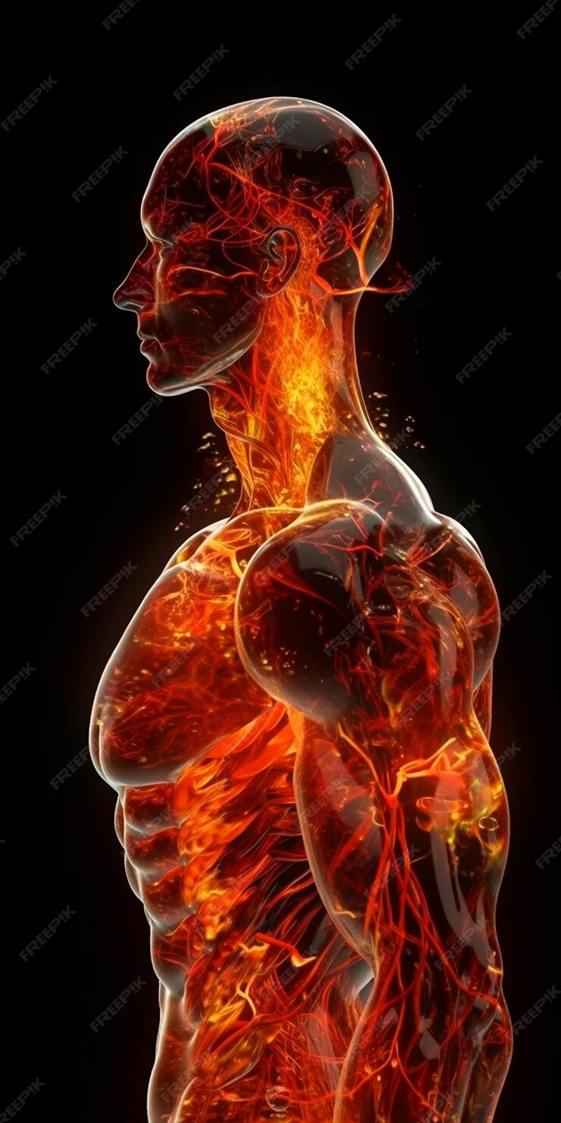
Analysis and Interpretation
Play Narration
Not all individuals exhibit the same sensitivity to fire effluents, impairment factors inherent to an individual unrelated to the fire may also be present. Differences in age, mental capacity, physical handicaps, medication, and drug usage can all affect individual responses to fire.
Threshold criteria of tenability developed through research and relied on for building design and the development of codes can provide the investigator with guidelines to assess the reasons why a fatality occurred in a particular fire.
27
27
Notes:
Not all individuals exhibit the same sensitivity to fire effluents; impairment factors inherent to an individual unrelated to the fire may also be present. Differences in age, mental capacity, physical handicaps, medication, and drug usage can all affect individual responses to fire. Threshold criteria of tenability developed through research and relied on for building design and the development of codes can provide the investigator with guidelines to assess the reasons why a fatality occurred in a particular fire.
In the Case Study after being awakened and going to investigate, the mother observed a small fire, approximately 1 ft. in height, on the arm of a sofa in the southeast corner of the living room, returned to her bedroom to retrieve her daughter, and exited through the kitchen and dining room from the back door. These were accounted for in the model.
While the mother’s description of the time interval is ambiguous, the conditions of tenability predicted by the analysis during this interval of time indicate temperature, oxygen, carbon monoxide, and carbon dioxide levels, and concentrations were below threshold limits.
The nature of the fuels involved at this stage of the fire (i.e., polyester and nylon fabric, as well as polyurethane foam, comprising the couch) would have been the primary contributing factor to smoke production during this time, rather than a lack of ventilation or available oxygen.
Given the age, medical condition, and impairment of the grandmother, it is unlikely she could have self-evacuated from the master bedroom, irrespective of when she became aware of the fire.
The grandmother’s Carboxyhemoglobin level was 79.8 %, and the young boy’s was 86.4%, as determined by forensic toxicology. The cause of death with respect to both was listed as smoke inhalation accompanied by a significant elevation in postmortem carboxyhemoglobin. Forensic toxicology reports were not performed to determine the presence or levels of hydrogen cyanide.
Click the Next button below to continue.

Slide 28

Analysis and Interpretation
Play Narration
If an occupant is delayed, trapped, or becomes incapacitated, conditions during a fire can deteriorate rapidly and reach lethal levels.
The ability of an individual to escape is measured in the time frame for which their environment remains survivable.
The human response to fire involves a behavioral component that cannot be predicted by FDS.
.
28
28
Notes:
If an occupant is delayed, trapped, or becomes incapacitated, conditions during a fire can deteriorate rapidly and reach lethal levels.
The ability of an individual to escape is measured in the time frame for which their environment remains survivable.
The son, age 8, who reported the fire earlier to his mother and was asleep in a hall bedroom, had no known medical impairments, was obviously aware of the fire, and was physically capable of self-evacuating. The psychological behavior and responses of children to fire, however, are more complex and less predictable than those of adults. Whether attempting to escape the fire, out of panic, fear, and either a desire to help or not abandon his grandmother, he remained inside the master bedroom, where conditions eventually became untenable, and he was later found with his grandmother.
While conditions inside the master bedroom remained tenable for a period of time, conditions inside the dining room (the only remaining path of egress) deteriorated rapidly after the mother’s exit from the dwelling. Aided by the rear door being left open, minimum threshold levels of visibility and temperature were exceeded quickly thereafter, blocking re-entry into the structure or egress from it.
The mother broke the back window of the master bedroom shortly after her exit before going next door to a neighbor who called 911 and reported the fire. By then, although egress into or from the dwelling was blocked, conditions inside the master bedroom remained tenable until approximately the same time that firefighters were dispatched to the scene. By the time they arrived, these conditions had deteriorated.
Investigators should recognize that the comprehensive analysis of fire also involves a behavioral component that significantly influences an occupant's reaction to fire, and that FDS does not address, nor can it.
Click the Next button below to continue.

Slide 29
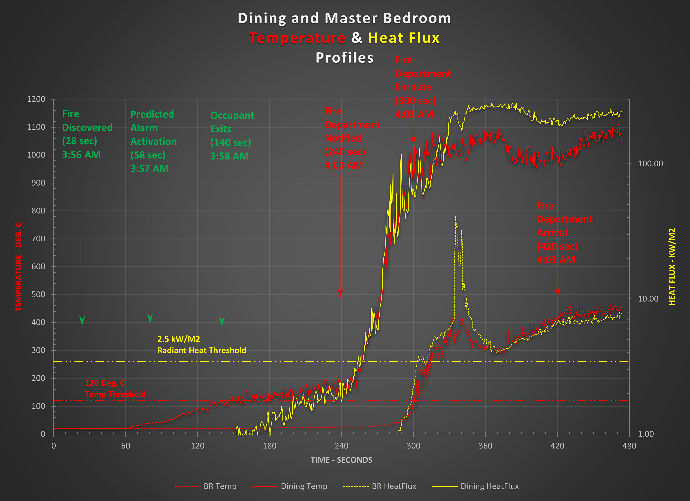
Thermal Impact
Play Narration
Raw data can be imported into an Excel spreadsheet, analyzed, and graphed to visualize its relationship to other data and its significance to benchmark events over time.
Temperature and radiant heat data, for example, can be plotted over time to reveal when threshold limits are reached during the fire’s development and against benchmark events compared against threshold values derived from research.
29
29
Notes:
Raw data can be imported into an Excel spreadsheet, analyzed, and graphed to visualize its relationship to other data and its significance to benchmark events over time. Temperature and radiant heat data, for example, from the previous Case Study can be plotted over time to reveal when threshold limits were reached during the fire’s development and against benchmark events compared against threshold values derived from research.
Benchmark Events, can included and labeled and charted against tenability criteria derived from research and not based solely on the fire investigator’s assessment.
This includes
Smoke Alarm Activation
Opening of a door or window
Time of Fire Department Notification
Time of fire department arrival.
Time fire ground operations commenced.
In the example given, the graphic shown indicates key benchmarks such as when the fire was first discovered, when the smoke alarm was activated in response to the fire, when one of the occupants first exited, when the fire department was notified, when the fire department was enroute, and when the fire department arrived. All are plotted on a double axis on an EXCEL spreadsheet
For comparison, the normally accepted tenability criteria for temperature is 120 degrees. Celsius or 250 degrees Fahrenheit and can be plotted against these benchmarks. For small enclosures, this may be achieved when the upper hot layer temperature rises above 200 degrees Celsius. The normally accepted threshold for tolerance to radiant heat is 2.5 kilowatts per square meter.
Click the Next button below to continue.

Slide 30
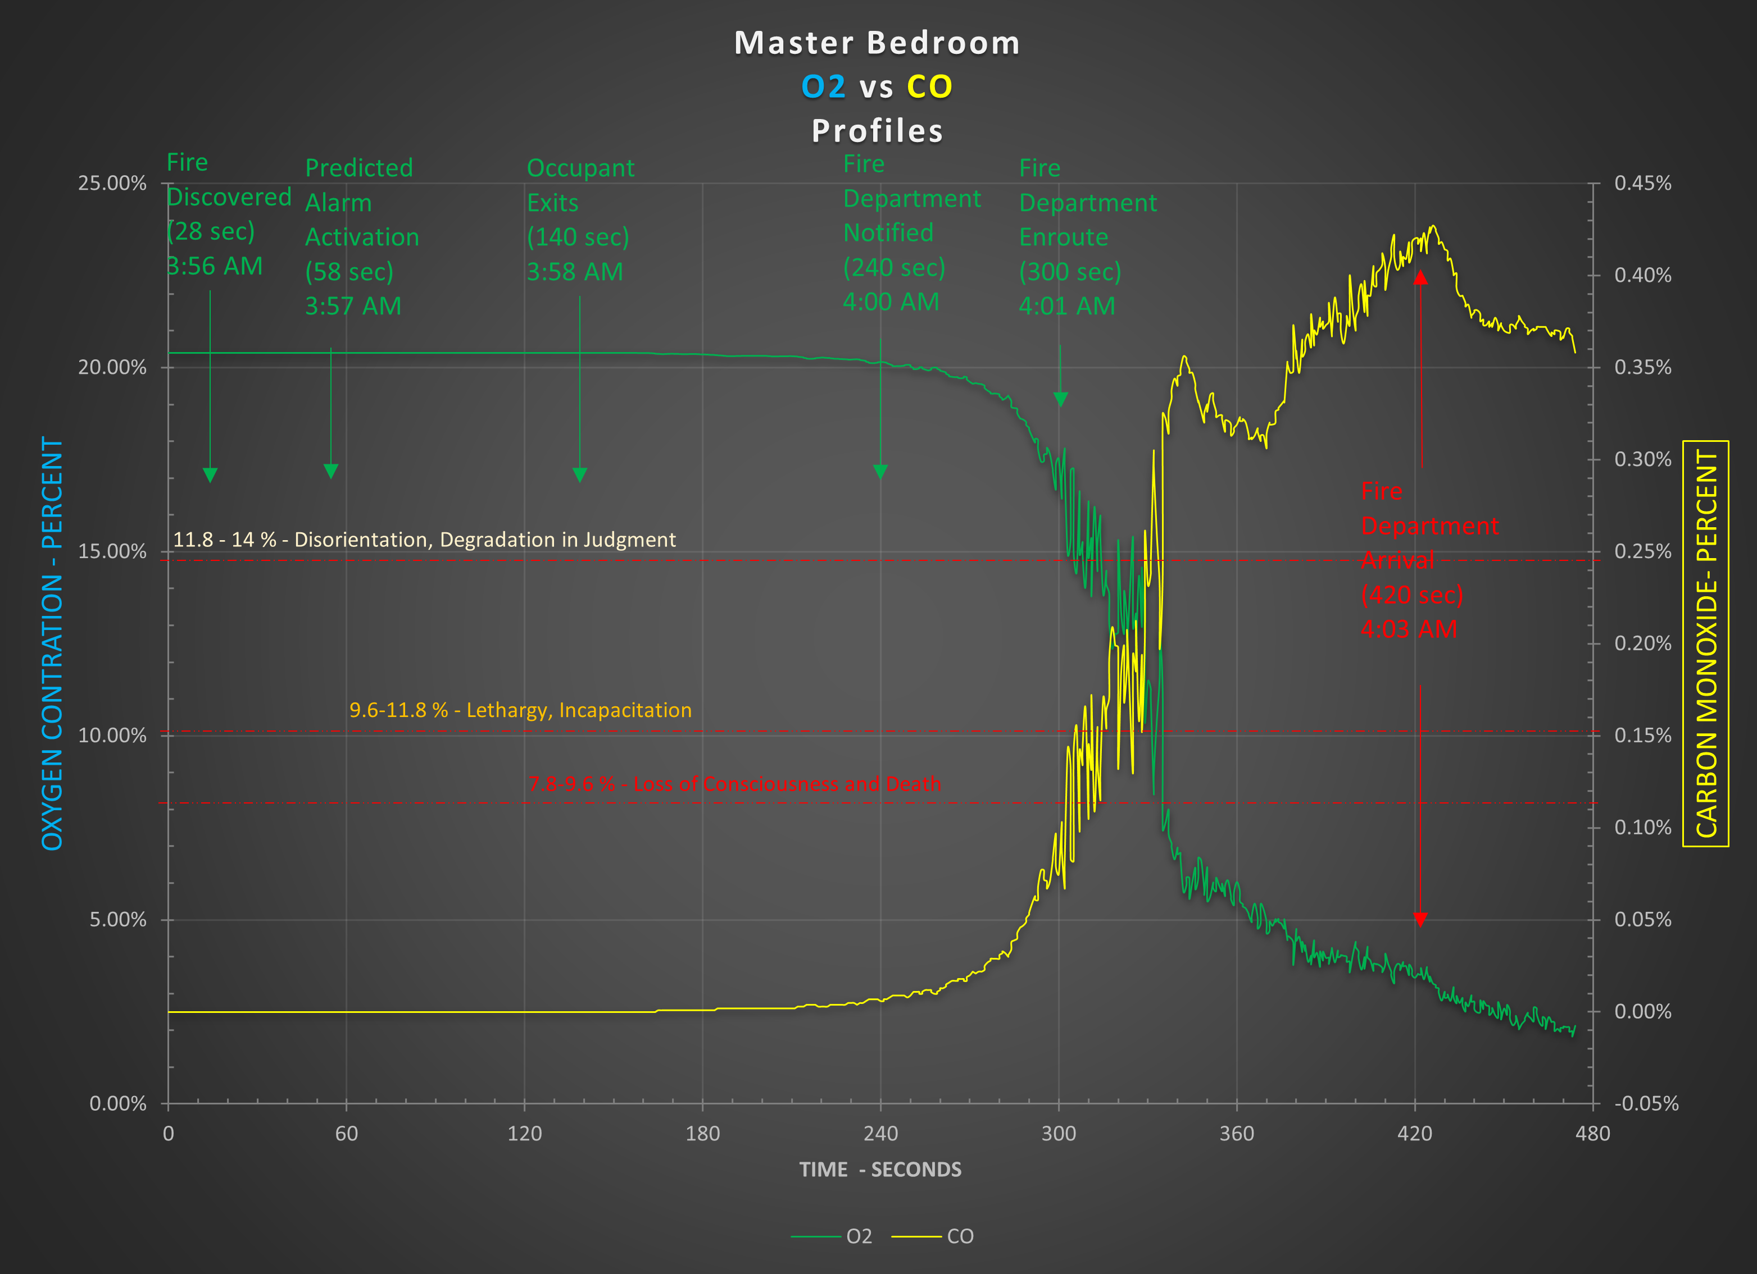
Impact of O2 Deprivation (Hypoxia)
Play Narration
Oxygen and Carbon Monoxide concentrations can be plotted over time to reveal when threshold limits are reached during a fire’s development and against benchmark events compared against threshold values derived from research.
30
30
Notes:
The same process applies to Oxygen and fire effluents asphyxiant gases that can result from either natural combustion or incomplete combustion.
Critical hypoxia is typically reached when the oxygen concentration drops below 10 percent. Hence, it should be assumed that escape would not be possible at oxygen concentrations below that level. Tenability Limits for Oxygen Concentration are described as follows.
At 14.14-20.9 percent Oxygen, readily observable effects are apparent.
At 11.18-14.14 percent oxygen, there is a concentration, disorientation, and degradation in judgment.
At 9.6-11.8 percent, Oxygen Lethargy, incapacitation, and loss of consciousness occur.
At 7.8-9.6 percent oxygen, Loss of consciousness or death occurs.
Carbon Monoxide is always present in some concentration in all fires, irrespective of the materials involved and the stage of the fire. The lowest concentration of a material in air that has been reported to cause death in humans is referred to as the Lethal Concentration Low. The LCL0 for carbon monoxide inhalation is listed at 0.5 % (5,000 parts per million) for 5 minutes.
Click the Next button below to continue.

Slide 31
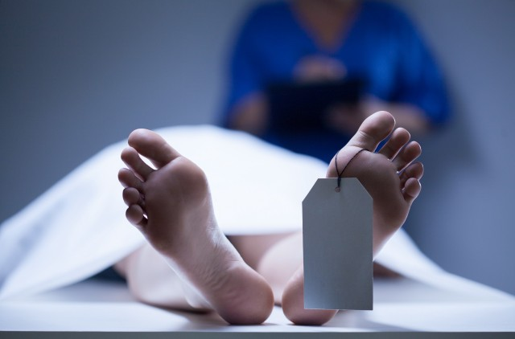

Conclusions
Play Narration
Time is a key determinant of survival and not a friend during a fire. The ability of an individual to escape a fire is measured by the time frame for which their environment remains tenable.
Of primary concern is the point at which exposure to one or more variables (e.g., visibility, toxic gases, and heat) would cause injury or block the individual from successfully escaping the fire, resulting in death.
If an occupant is delayed, trapped, or becomes incapacitated, conditions during a fire can deteriorate rapidly and reach lethal levels.
31
31
Notes:
Time, a key determinant of survival, is not a friend during a fire. The ability of an individual to escape a fire is measured by the time frame for which their environment remains tenable. Of primary concern is the point at which exposure to one or more variables such as visibility, toxic gases, and heat would cause injury or block the individual from successfully escaping the fire, resulting in death. If an occupant is delayed, trapped, or becomes incapacitated, conditions during a fire can deteriorate rapidly and reach lethal levels.
Overall, while FDS can be a useful tool for modeling smoke detector activation, its accuracy can vary based on the type of detector and the specific conditions of the fire scenario.
The accuracy of these predictions depends on several factors: Overall, while FDS can be a powerful tool for predicting smoke detector activation times, it's important to validate the model against experimental data and consider the specific context of the fire scenario. Research has shown that FDS models can closely match experimental data, with mean errors as low as 7 percent in some studies, regarding the accurate prediction of smoke detector activation time when properly configured. This accuracy is achieved by using detailed algorithms and parameters that simulate the behavior of smoke detectors in various fire scenarios.
Fire Dynamics Simulator (FDS) has shown varying levels of accuracy in predicting smoke detector activation, depending on the type of smoke detector and the specific fire scenario:
FDS simulations have demonstrated high accuracy in predicting the performance of Aspirating Smoke Detection or ASD systems in tested scenarios. These systems are generally more sensitive and can detect smoke particles at lower concentrations.
The accuracy of FDS predictions for conventional point-type smoke detectors, such as photoelectric and ionization detectors, is less consistent. Studies have shown significant discrepancies between experimental results and FDS simulations for these detectors. Factors contributing to these inconsistencies include the complex fire environments and the overestimation of soot levels in large fires by FDS.
In a related issue, the National Fire Protection Association of NFPA sets benchmarks for fire department response times in the United States through NFPA 1710. These standards aim to ensure effective and timely emergency responses to and to enhance public safety. Factors such as geographic layout, traffic conditions, staffing levels, and equipment readiness can influence actual response time.
Some key benchmarks include a Call Processing Time of no more than 64 seconds 95% of the time and a requirement that firefighters be suited and in their apparatus within 80 seconds for fire responses and 60 seconds for EMS calls.
First responders should arrive on the scene within 240 seconds or 4 minutes for fire suppression and EMS incidents 90 percent of the time.
I the previous example, given the predicted timeline of the fire and its development, even under the best of fire ground conditions, it is unlikely firefighters could have forced entry through the front door of the residence, controlled the fire, and located the occupants inside the master bedroom before tenability conditions inside the master bedroom had since transitioned from threshold incapacitation levels to lethal levels, resulting in the death of the occupants inside the room.
Based on experience, knowledge, and training, our review of the materials provided, and the fire dynamics analyses, we concluded with reasonable certainty as probable that a properly inspected, maintained, and operable smoke alarm installed in the residence in accordance with applicable codes, standards, statutes, and alarm manufacturer’s recommendations, would not have detected the fire at an earlier point in time than that testified to by the occupant nor prevented the deaths of the two occupants.
Click the Next button below to continue.

Slide 32
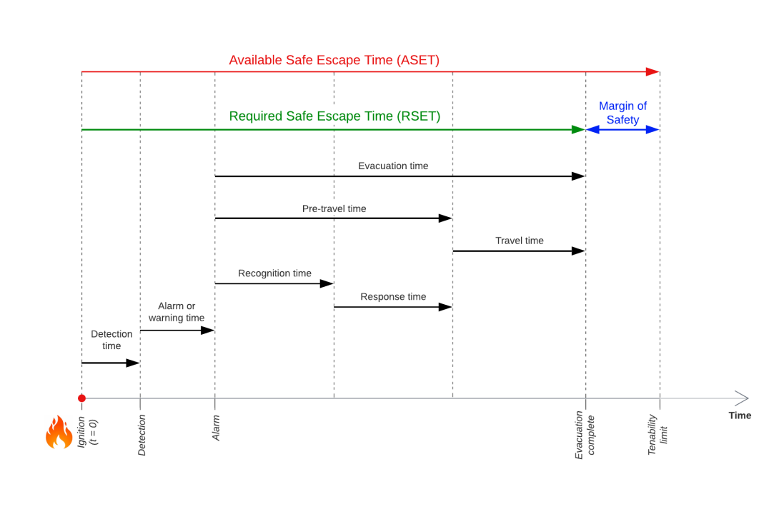

The concept of ASET/RSET
Play Narration
. RSET (Required Safe Egress Time) is the time needed to evacuate from a building..
Fire simulations aim to determine if ASET is greater than RSET plus a safety factor. The main reason for a safety factor is to account for uncertainty. Evacuation models.
For survivability considerations, ASET (Available Safe Egress Time) is considered a ‘worst-case’ scenario and is heavily influenced by Tenability.
(Influenced by Human Behavior)
(Heavily influenced by Tenability)
32
32
Notes:
During fires, the Available Safe Egress Time (ASET) is determined by tenability, which, in turn, is influenced by both the individual and the environment. ASET is the time needed to survive. For survivability considerations, ASET is considered a ‘worst-case’ scenario for a building and is more heavily influenced by the physical limitations of the occupants.
The required safe egress time (RSET) is influenced, in part, by human behavior, a quality that FDS does not predict. Fire simulations aim to determine if ASET is greater than RSET plus a safety factor. The main reason for a margin of safety in any simulation is to account for uncertainty.
Again, NFPA 921 specifically warns against using FDS solely to determine a fire’s origin and cause. Although important, a fire’s origin and cause are sometimes not the only issues to be resolved by fire investigators who are frequently asked to assess the extent of damage caused by the fire in terms of the amount, usually expressed as a percentage that, in turn, relates to dollars. Users of FDS, like all experts, should stay within their areas of expertise, based on their knowledge, training, and experience, regardless of whether they are fire investigators or not.
Click the Next button below to continue.

Slide 33
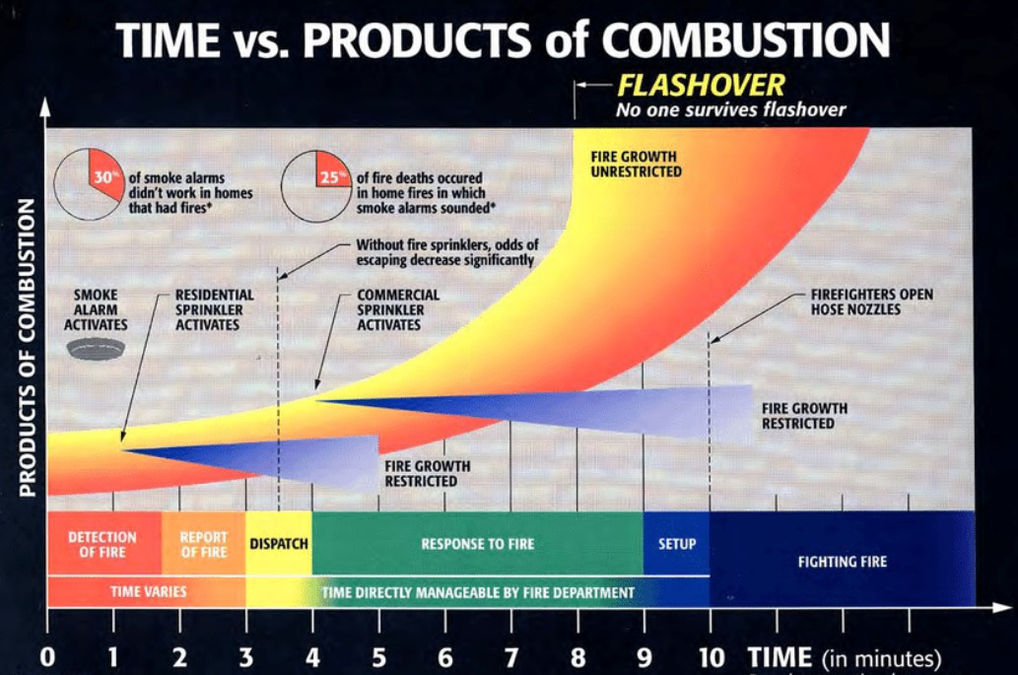
The impact of a fire
Play Narration
The thermal effects of fire are generally the first to impact and affect occupants, followed by other effluents, typically asphyxiant gases (e.g. CO, CO2, HCN, and Smoke (which impacts visibility) and Hypoxia (i.e.. Oxygen deprivation).
33
33
Notes:
The threshold at which an environment becomes untenable varies with the individual, the building, the fire. and the environment. The thermal effects of fire are generally the first to impact and affect occupants, followed by other effluents, typically irritants, asphyxiant gases, and Oxygen depletion.
Soot and smoke can contribute to fire deaths and injuries through several mechanisms. All are important considerations, both singularly and collectively, during the investigation of a fire. Soot and smoke particles can be inhaled, causing thermal injuries and leading to edema in the respiratory system. and/or their contribution to reduced visibility may hinder egress or escape.
Click the Next button below to continue.

Slide 34
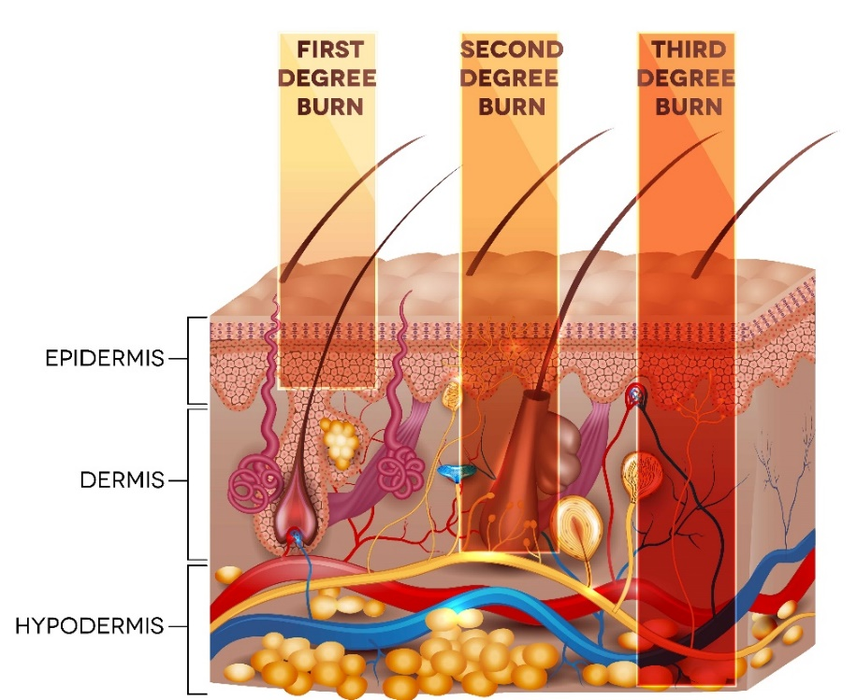
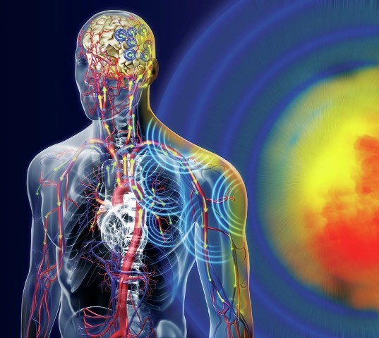
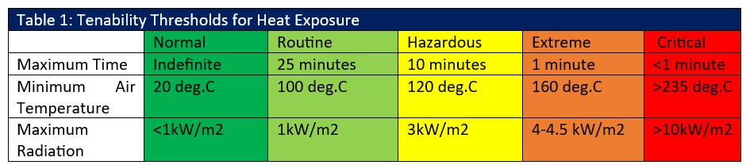
The impact of thermal exposure
Play Narration
FDS focuses on the physical impact of fire on the structure and its occupants, not its psychological or behavioral impact.
To properly interpret the impact of a fire, an investigator must compare its predictions against known and accepted principles that have been documented through standards and research.
Standardization provides a consistent and objective set of criteria that can be applied universally. This ensures that conclusions are not subject to individual interpretation, which can vary widely.
  Evidence-Based: Benchmarks are typically based on extensive research and data analysis, ensuring that they reflect the latest scientific understanding and best practices. This makes them more reliable than personal experience, which may be limited or outdated.
  Admissibility: Using standardized benchmarks increases the probability of admissibility in legal matters because they are based on widely accepted standards.
34
34
Notes:
To properly interpret the impact of a fire, an investigator must compare its predictions against known and accepted principles that have been documented through standards and research. Standardization provides a consistent and objective set of criteria that can be applied universally. This ensures that conclusions are not subject to individual interpretation, which can vary widely. Using benchmarks rather than relying solely on an investigator's experience offers several advantages.
Benchmarks are typically based on extensive research and data analysis, ensuring that they reflect the latest scientific understanding and best practices. This makes them more reliable than personal experience, which may be limited or outdated. Using standardized benchmarks increases the probability of admissibility in legal matters because they are based on widely accepted standards.
Benchmarks for tenability during fires are crucial for ensuring the safety of occupants and firefighters, as well as for interpreting the simulation output of FDS. Here are some key benchmarks:
The air temperature should not exceed 60° Celsius or 140 degrees Fahrenheit for prolonged exposure, as higher temperatures can cause heat stress and burns.
Burns are the effects of heating the skin and occur regardless of whether the heat is supplied by conduction from a hot body, convection from air contact, or the radiant transfer of heat from a fire. Pain from applying heat to the skin occurs when the skin temperature at a depth of 0.1 mm reaches 44.8 degrees Celsius or 112.4 degrees Fahrenheit). Radiant heat flux is also a significant survivability factor and becomes the dominant heat transfer mechanism during the latter part of a fire’s development. The threshold limit commonly accepted for incapacitation related to radiant heat is 2.5 kW/m2, which, in smaller compartments, may be reached when the hot layer temperature rises above 200 degrees Celsius By comparison, 20 kW/m2 is frequently cited as the floor level radiant heat flux at the beginning of flashover when upper gas layer gas temperatures reach 500-600 degrees Celsius the fire transitions from a fuel-controlled to a ventilation-controlled one, threatening occupants outside the room or compartment of origin.
The reduction in visibility alone from combustion byproducts will not incapacitate individuals, cause death, or prevent an occupant from escaping or evacuating through the smoke, and is not a tenability endpoint. Visibility limits are cited as 5 meters for small enclosures and 10 meters for large ones. While not directly life-threatening, a reduction in visibility may, however, have both behavioral and physiological implications leading either to the decision of an occupant not to evacuate or delay or slow their evacuation, thereby increasing exposure to both toxic gases and heat and preventing a timely escape before conditions become untenable.
ISO 13571:2012 establishes procedures to evaluate the life-threatening components of fire hazard analysis in terms of the status of exposed human subjects at discrete time intervals. It makes possible the estimation of the time at which occupants can experience compromised tenability. It enables the estimation of a compromised tenability endpoint for each of the fire effluent components, with the most important endpoint being the earliest to occur. Together with the SFPE Guide to Human Behavior in Fire (Society for Fire Protection Engineers), the international ISO standard can, with care, provide guidance when applied to the estimation of the time limits for tenability. SFPE Guide to Human Behavior in Fire also provides an overview and summary of various topics that underlie how occupant characteristics influence the response, reactions, and movement of occupants in a fire.
Click the Next button below to continue.

Slide 35
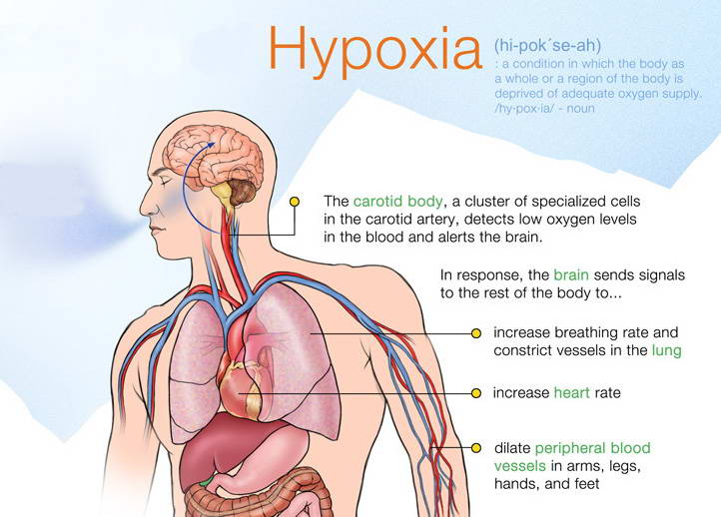
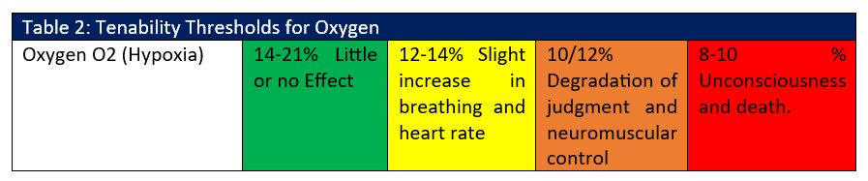
Play Narration
The impact of Oxygen Deprivation (Hypoxia)
A reduced oxygen environment occurs in an enclosure fire as a natural consequence of the combustion process. Reduced environmental oxygen, which is down to 15 percent oxygen in the air, has a negligible effect. However, as the oxygen concentration in inhaled air decreases from 15 percent to 10 percent, a gradual increase in respiration occurs, followed by disorientation and loss of judgment.
Critical hypoxia is typically reached once the oxygen concentration drops below 10%. Hence, it should be assumed that escape would not be possible at oxygen concentrations below 10-%.
35
35
Notes:
A reduced oxygen environment occurs in an enclosure fire as a natural consequence of the combustion process. The body has compensatory mechanisms that maximize the supply of oxygen to vital organs when low oxygen concentration is encountered in environmental air, such as at high altitudes or during exercise. Compensation mechanisms, however, can be overwhelmed when oxygen depletion becomes significant, as during fires. Reduced environmental oxygen, which is down to 15 percent of the air’s oxygen content, however, there are little to no effects on physiological functions or degradation of higher mental processes and loss of neuromuscular control, loss of critical judgment, and volution with dulling of the senses, and a marked increase in cardiovascular and respiratory activity. However, as the oxygen concentration in inhaled air decreases from 15 percent to 10 percent, a gradual increase in respiration occurs, followed by disorientation and loss of judgment. Critical hypoxia is typically reached once the oxygen concentration drops below 10 percent. This concentration marks the point at which rapid deterioration in judgment and compensation occurs and leads to unconsciousness. Hence, it should be assumed that escape would not be possible at oxygen concentrations below 10 percent.
Click the Next button below to continue.

Slide 36
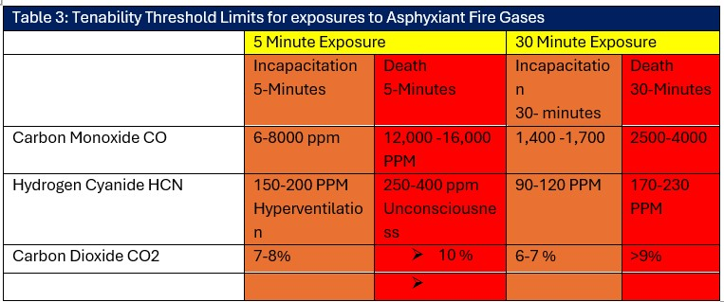
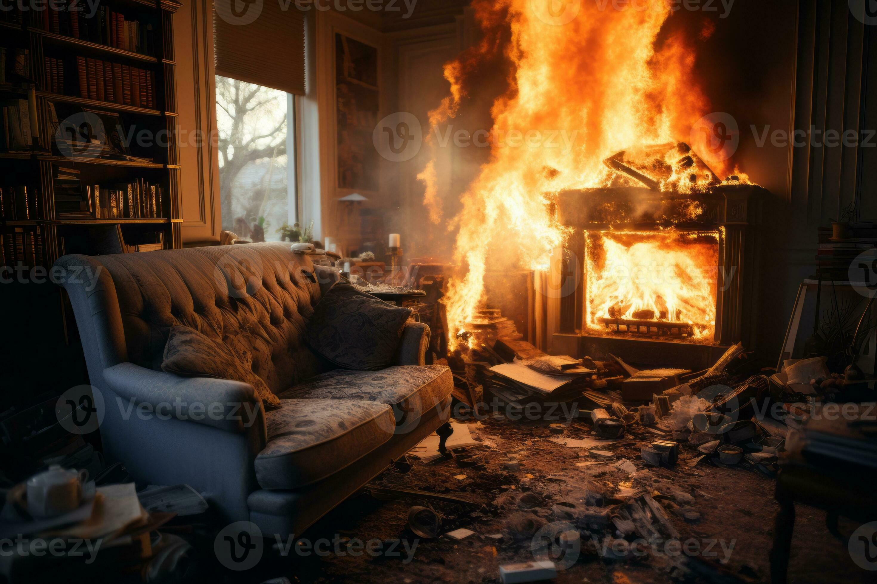
The impact of Asphyxiant Gases
Play Narration
Fire effluents, such as Carbon Monoxide, and Hydrogen Cyanide are narcotic gases that cause loss of alertness (intoxication), mental function, and psychomotor ability and the ability to carry out simple coordinated movements as are required in exiting a building.
Carbon Dioxide increases respiration, resulting in the individual breathing more CO and HCN.
The impact of HCN exposure is more rapid and dramatic than Carbon Monoxide or Oxygen deprivation.
36
36
Notes:
Irritant gases can alert people to the presence of a fire, even at low concentrations. Because of the unpleasant irritation of the eyes and respiratory tract, they may be motivated to escape. As the irritant effects become more pronounced, irritancy can directly impact individuals' ability to see and, in this way, may interfere with exiting behaviors. Post-fire effects of these irritants can be lung edema and inflammation.
Fire effluents such as Carbon monoxide and Hydrogen Cyanide are both narcotic gases that cause loss of alertness, mental function, and psychomotor ability and the ability to carry out simple coordinated movements as are required in exiting a building. Carbon Dioxide increases respiration, resulting in the individual breathing more uptake in both.
Click the Next button below to continue.

Slide 37
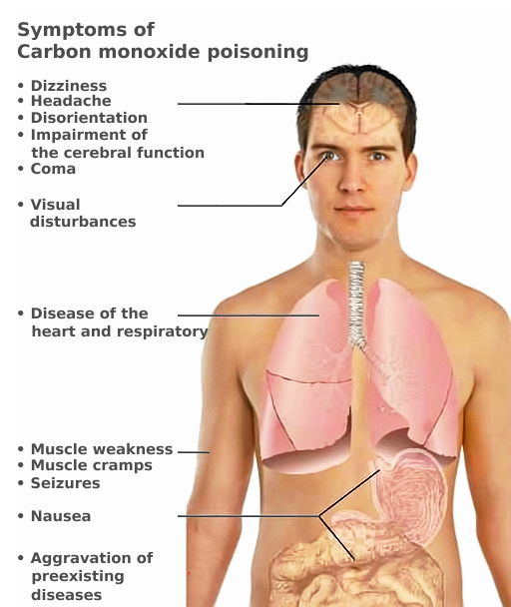
The impact of Carbon Monoxide Exposure
Play Narration
Effects of carbon monoxide in relation to the concentration in parts per million in the air:
Concentration | Symptoms
35 ppm (0.0035%), (0.035‰) | Headache and dizziness within six to eight hours of constant exposure
100 ppm (0.01%), (0.1‰) | Slight headache in two to three hours
200 ppm (0.02%), (0.2‰) | Slight headache within two to three hours; loss of judgment
400 ppm (0.04%), (0.4‰) | Frontal headache within one to two hours
800 ppm (0.08%), (0.8‰) | Dizziness, nausea, and convulsions within 45 min; insensible within 2 hours
1,600 ppm (0.16%), (1.6‰) | Headache, increased heart rate, dizziness, and nausea within 20 min; death in less than 2 hours
3,200 ppm (0.32%), (3.2‰) | Headache, dizziness and nausea in five to ten minutes. Death within 30 minutes.
6,400 ppm (0.64%), (6.4‰) | Headache and dizziness in one to two minutes. Convulsions, respiratory arrest, and death in less than 20 minutes.
12,800 ppm (1.28%), (12.8‰) | Unconsciousness after 2–3 breaths. Death in less than three minutes.
37
37
Notes:
Carbon monoxide is produced at some level in every fire. All carbon-based fuels (e.g., wood, paper products, and plastics) produce carbon monoxide due to incomplete combustion. In residential or building fires, elevated levels of Carbon Monoxide are always present at a higher concentration due to the combustion chemistry underlying the majority of the fuels comprising the building’s construction and its contents.
Most fires do not produce lethal levels of CO until the fire becomes ventilation-controlled. Studies have shown that 60 percent or more of fire victims die from carbon monoxide poisoning. Due to the transport of CO, most of these people are typically found outside the room of origin. Most fires do not produce lethal levels of CO until they become ventilation-controlled (the exception is smoldering fires). Thus, victims of carbon monoxide inhalation are typically found outside the room of origin unless the fire resulted from a locally under-ventilated or smoldering ignition. However, during flashover, thermal injury and lack of oxygen can cause death before substantial concentrations are developed. The same can occur if the victim is involved in a flash fire involving fuel gases or vapors.
In well-ventilated fires, the level of Carbon Monoxide produced may be as little as a few hundred parts per million (i.e., 0.02 percent). However, in under-ventilated, smoldering, or post-flashover fires, concentrations of 1 percent to 10 percent of 10,000 ppm to 100,000 ppm can be produced. Elevated CO concentrations can also develop during fire suppression
Nonsmokers average approximately 1 percent COH5 in their blood. By comparison, a smoker may be exposed to CO levels of 400-500 ppm during an average 6-minute duration to smoke a cigarette. Smokers typically have a COH range of 3 - 8 percent, with an average baseline of 4 percent. Heavy smokers (greater than two packs per day) can reach levels as high as 15 percent.
.
The concentration of Carbon Monoxide in the blood during and after fires is a function of the inhaled concentration in the air and the duration of exposure. At concentrations of 10-20 per cent, occupants will experience headaches and abnormal vision; 20-30 per cent will experience headaches, nausea, and loss of fine motor skills; 20-40percent will experience incapacitation; and 50% will experience death. The LCL0 for carbon monoxide (inhalation) is listed at 0.5 percent or 5,000 parts per million for 5 minutes. The body’s update of Carbon dioxide ceases when breathing stops, but because it has a long half-life in the tissues of a deceased individual, it is easy to identify in toxicology screening of fire victims.
Click the Next button below to continue.

Slide 38

Play Narration
Reliability of Simulations
38
38
Notes:
The precision of a simulation refers to its deterministic capability and repeatability. The accuracy of a simulation refers to how well it replicates the evolution of a fire. The reliability of a simulation is determined by Validation, Verification, and a Sensitivity Analysis
Developers normally perform Validation and Verification as evidenced by documentation. Users normally perform Sensitivity Analyses to determine which input parameters have the most significant impact on simulation results. A Sensitivity Analysis is essential for understanding the behavior of fire dynamics and ensuring accurate predictions.
Click the Next button below to continue.

Slide 39
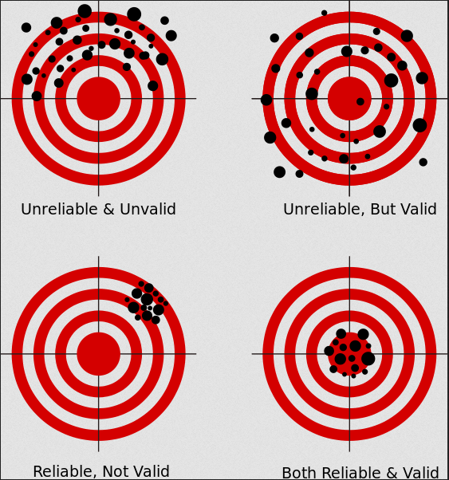
Play Narration
Verification and Validation of FDS
Verification: This step ensures that the source code of the simulation contains no errors and corresponds exactly to what is described in the code documentation.
Validation: Validation of a fire model refers to the process of assessing the accuracy and reliability of the simulation’s predictions in its intended use.
Comprehensive documentation and guidelines for (FDS) is found on the National Institute of Standards and Technology (NIST) website.
39
39
Notes:
Verification ensures that the source code of the simulation contains no errors and corresponds exactly to what is described in the code documentation. Essentially, it checks the correctness of the implementation.
Validation assesses the accuracy of the simulation’s predictions in its intended use. It involves comparing the model’s output to experimental data or observations. If the model’s predictions closely match the real-world behavior, it is considered validated for that specific application. Validation of a fire model refers to the process of assessing the accuracy and reliability of the simulation’s predictions in its intended use. Validation typically includes comparing the model’s predictions (such as fire behavior, smoke movement, or heat transfer) to empirical measurements obtained from controlled experiments or actual fire incidents and provides confidence that the simulation produces reliable results and can be used effectively for safety assessments, risk analysis, and decision-making.
Comprehensive documentation and guidelines exist for Fire Dynamics Simulator (FDS) on the National Institute of Standards and Technology (NIST) website and includes the FDS User's Manual that provides detailed instructions on how to use the Fire Dynamics Simulator, including installation, running simulations, and interpreting results and a Technical Reference Guide, Verification Guide, and Validation Guide.
Click the Next button below to continue.

Slide 40

Verification and Validation
Play Narration
ASTM E1355-12 is a standard guide that provides a methodology for evaluating the predictive capabilities of a fire model for a specific use. The intent is to cover the whole range of deterministic numerical models, including FDS, that might be used in evaluating the effects of fires in and on structures.
.
40
40
Notes:
The process of evaluation is crucial to establishing both the acceptable uses and limitations of fire models and simulations.
Validation for one application or scenario does not imply validation for different scenarios.
Several alternatives are provided for performing the evaluation process, including a comparison of predictions against standard fire tests, full-scale fire experiments, field experience, published literature, or previously evaluated models.
ASTM E1355-12 is a standard guide developed by ASTM International for evaluating the predictive capability of deterministic fire models. This guide provides a methodology for assessing how well a fire model predicts the behavior of fires in specific scenarios. It is used by developers to document the usefulness and limitations of their models and by users to ensure they are using appropriate models for their applications.
Click the Next button below to continue.

Slide 41
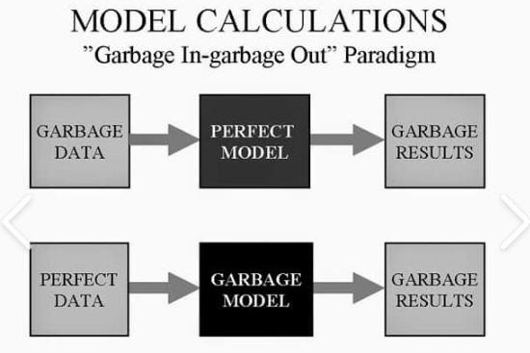
Sensitivity Analysis
Play Narration
Sensitivity Analysis
Sources of Uncertainty:
  Uncertainties in simulations arise from:
    Model Assumptions: Assumptions made during model development. This typically involves simplification to make the model(s) upon which the simulation is based tractable.
    Input Data: Whether data is based on measurements, expert judgment, or environmental conditions.
    Material Properties: Properties of fuels, building materials, etc.
41
41
Notes:
The accepted and peer-reviewed methodology for using computer fire simulations involves providing a range of variables to evaluate both the sensitivity of the model and ensure that variables not specifically known are accounted for within the model. A Sensitivity Analysis for each simulation is required by NFPA 921 to account for its uncertainty.
Uncertainties in simulations may arise from assumptions made during model development. Uncertainty typically involves simplification to make the model(s) upon which the simulation is based tractable, encompassing both the model’s input and the source of its data, whether it is based on measurements, expert judgment, or environmental conditions. Uncertainty may also arise because the thermophysical properties of the materials that comprise the building and its contents do not accurately represent those of the fuels involved in the actual fire.
A simulation, for example, can be reliable (i.e. produce the same result time after time with the same input) but still not simulate the actual fire either because the underlying model(s) is wrong or because the data is not the same as the actual fire and circumstances being simulated (e.g. the wrong data is entered.)
Click the Next button below to continue.

Slide 42
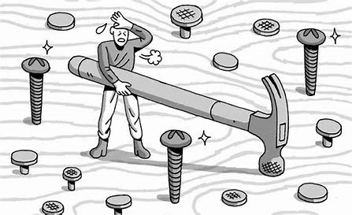
Play Narration
Deciding whether FDS should be used
Cost-Benefit Analysis?
Can the simulation answer the question(s) that need answered?
Is there sufficient data or can it be obtained?
Is the user qualified to both construct the simulation and analyze its results ?
When all you have is a hammer every problem
Looks like a nail.
42
42
Notes:
FDS should not be used unless the issues or value of the matter justifies the time and expense of using it, and it can answer the question(s) that need to be addressed with the required degree of accuracy.
Sufficient data must be available to construct the simulation, or it must be obtained through further investigation. There may be simpler tools or models that can be used to arrive at a solution.
Lastly, the user of the simulation must be qualified to construct it, perform the analysis, and, very importantly, interpret its results.
Click the Next button below to continue.

Slide 43



Limitations of FDS
Play Narration
Low-speed flow limitation
Simplified chemical model
Accuracy near flashover
FDS is designed for low-speed flows with Mach numbers less than 0.3, meaning it cannot accurately simulate high-speed flows like detonation, explosions, or choked flow at nozzles.
FDS uses a simplified chemical model by default to simulate fire and combustion processes, which may not be representative of all fuels involved in a fire. More complex chemistry can be incorporated, but the simplified model is often adequate for general fire safety analysis.
FDS simulations are generally less accurate when a fire reaches flashover conditions, and other fire models (e.g., P-Flash) may be more appropriate for long-duration fires. However, FDS can be used to predict the conditions required to approach and reach flashover.
43
43
Notes:
Users must be aware of the limitations and assumptions of FDS not only to properly construct the simulation to represent the actual fire scenario being investigated but also to assess its output.
Sensitivity analysis and proper interpretation of results are crucial to ensure the reliability of FDS-based findings. Investigators unfamiliar with FDS often fail to understand its limitations and deterministic nature.
FDS, like most simulations based on fire models, is deterministic in that the user who relies on it to construct a fire simulation defines where a fire originates. The location of the ignition source of a fire usually coincides with the point of origin as identified either by witness description or is determined by a fire investigation. This may, and frequently is, contested by other experts.
FDS alone can not predict the origin of a fire or its cause. NFPA 921 does not recommend its use for those purposes. If, for example, FDS simulates a fire that originates in a trash can, it will have the same input and output but cannot tell the user whether a cigarette was accidentally or intentionally tossed into the trash can. Likewise, it cannot predict why an occupant in the same structure perished in the fire rather than escaped. FDS can not predict the psychological state of an occupant, where it began, or its cause. It can help the user assess the physical impact of a fire on the structure, its contents, or its occupants.
Model users sometimes use FDS beyond its limitations. For example, FDS is designed for low-speed flows with Mach numbers less than 0.3, meaning it cannot accurately simulate high-speed flows, such as detonations or explosions.
Users sometimes use default values provided with the simulation or unsubstantiated data instead of actual data that accurately represents the fire being simulated. The thermophysical properties of both the building and its contents may be unavailable. Additional research or actual testing of exemplars of these fuels may be necessary. FDS uses a simplified chemical model by default to simulate fire and combustion processes, which may not accurately represent all fuels involved in a fire. More complex chemistry can be incorporated but the simplified model is often adequate for general fire safety analysis.
FDS simulations are generally less accurate once a fire reaches flashover conditions (a natural phase in a compartment fire). Other fire simulations may be more appropriate for long-duration fires. However, FDS can be used to predict the conditions required to approach and reach flashover.
Users sometimes also fail to assess whether a hypothesis is consistent with accepted principles of fire science, fire behavior, and fire dynamics. Users may also fail to perform a sensitivity analysis, identify the potential error rate of the simulation output, or even construct the computational domain of the simulation accurately.
Click the Next button below to continue.

Slide 44

Common Mistakes in Using FDS
Play Narration
Using FDS without regard or beyond its limitations.
Errors in constructing the model.
Failure to perform a sensitivity analysis.
Failure to produce documentation.
Failure to define the error rate.
Use of FDS by unqualified users.
  .
44
44
Notes:
FDS is considered a reliable tool for fire modeling, but like any simulation, it has limitations and potential sources of error. The FDS Validation Guide discusses various sources of error, including numerical errors, uncertainties in measurements, and assumptions or simplifications in the physical model. The error rate of Fire Dynamics Simulator (FDS) can vary depending on several factors, including the complexity of the scenario being modeled, the accuracy of the input data, and the specific parameters used in the simulation
Common sources of error in FDS simulations include using FDS without regard or beyond its limitations. It is primarily designed for fire-driven fluid flow and smoke transport, particularly in low-speed flows. Failing to account for these limitations can lead to inaccurate results. Other third-party applications, such as FLACS-CFD, created by Gexcon, are widely used for explosion, fire, and dispersion modeling. They offer detailed three-dimensional visualizations that account for local geometrical effects, making them more ideal for explosions that occur at higher speeds. By default, FDS also uses simplified chemical models, which may not accurately represent all fire scenarios.
Errors in constructing the simulation - Inexperienced users may make mistakes in model construction, such as failing to encompass the entire area of the actual structure, using incorrect material properties, or attempting to use the model beyond its capabilities. Inaccurate or incomplete data about the material properties of the building and its contents leads to errors. Assumptions made about the fire's behavior, such as growth rate and heat release rate, can affect its accuracy. Incorrect information about airflow and ventilation can lead to discrepancies in the movement of smoke and heat.
Failure to perform a sensitivity analysis - Not conducting a thorough sensitivity analysis to assess the model's predictions' robustness and identify the most influential variables can lead to unreliable results.
Failure to produce documentation - Not retaining the original input and output files from the FDS simulation as part of the investigative record can hinder peer review and verification of the model's results.
Not expressing opinions and conclusions in terms of probability, as required by NFPA 921, can result in ambiguous and potentially misleading interpretations of the model's findings. Specific error rates for FDS are not typically quantified in a single value but rather are framed. Studies and validation exercises often compare FDS results with experimental data to assess accuracy.
Use of FDS by unqualified users - The use of FDS by users who have no experience in either fire investigation or expertise, knowledge, or training in basic fire science and fire dynamics. This may lead to over-reliance on the simulation and circular logic, a problem in itself. where one expert relies on the other’s opinion.
Click the Next button below to continue.

Slide 45
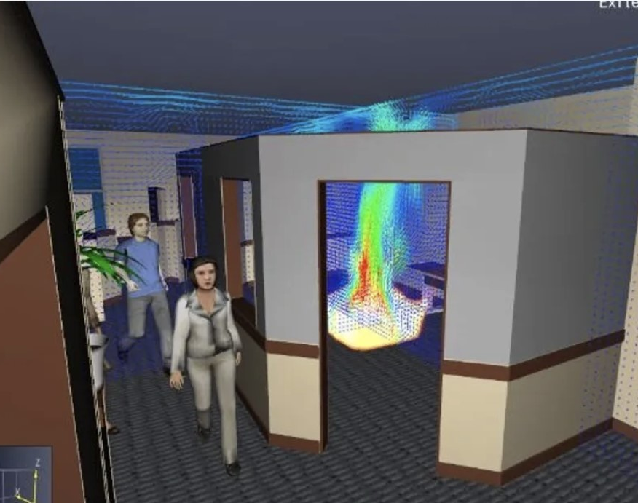
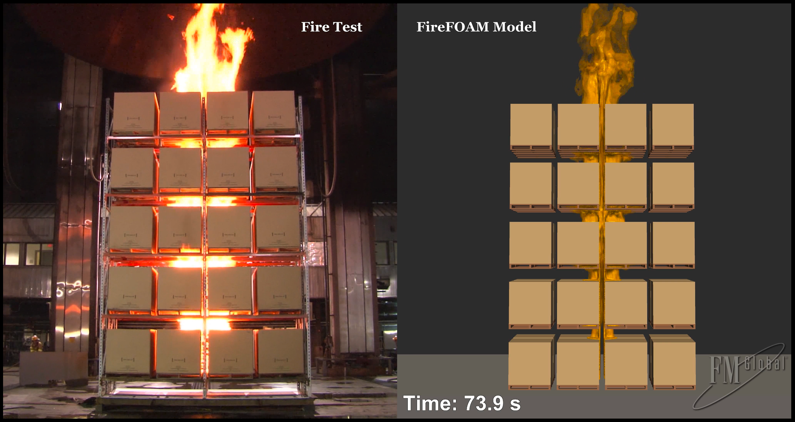
Play Narration
Realizations
FDS provides a methodology for performing a Fire Dynamics Analysis of a fire.
The predictive value of FDS is often ignored and either not understood or misstated.
The demonstrative value of simulations is sometimes overlooked.
45
45
Notes:
When used, the results of a simulation should be tied to previous observations or experiments that have been conducted for comparison or validated with a Sensitivity Analysis.
The distinction between a model, a simulation, and an animation can divert attention from their true value. A model is a simplified representation of a system that captures its essential features, while simulation involves running a model to observe how it behaves over time or under different conditions. Models can be used to make predictions or test hypotheses, while simulations allow for experimentation and exploration of different scenarios. Both modeling and simulation are valuable tools for understanding and improving systems, but they differ in their level of abstraction and the degree of interactivity they offer.
A model is a simplified representation of a system or phenomenon. It captures the essential features and relationships of the real-world entity it represents. Models can be physical, mathematical, or conceptual. Models are used to represent and understand systems, while simulations are employed to analyze and predict the behavior of systems based on these models. A model is based on physical evidence that has been verified through observation, research, and duplication, and whose error rate can be verified. Models can range from simple equations, equations grouped or coupled together as procedures, or complex models.
A simulation utilizes a model to examine the behavior of a system over time. It involves running experiments to observe outcomes under different conditions. Simulations are often used to predict future behavior, test scenarios, or understand complex systems. A simulation requires expert testimony regarding its underlying basis, and the witness must explain how the simulation was created and what its output is based on.
Both modeling and simulation are valuable tools for understanding and improving systems, but they differ in their level of abstraction and the degree of interactivity they offer. Models can be used to make predictions or test hypotheses, while simulations allow for experimentation and exploration of different scenarios.
An animation is a story told with the expectation that it accurately represents reality. People tend to believe what they see or hear, whether it is true or not. Animation is not linked to predictive data, but programmed and created by a person to whom the fire investigator explains the fire. An animation may or may not be based on a model or a simulation, but it is simply someone’s story based on their beliefs rather than science.
The demonstrative value of simulations is sometimes overlooked because they produce quantitative output or raw mathematical data that often takes center stage and lacks an explicit identification of an error rate (which is the basis of all scientific certainty). Simulations often involve running multiple scenarios and analyzing results, which can add complexity.
Technology will evolve and change, but human nature will not. In courtrooms or litigation, the truth is often determined by a vote, typically by a jury. and that people see what they believe, regardless of whether it is true or not, and particularly if it comes from a figure of authority, perceived or real.
. When using the scientific method, the failure to consider an alternative hypothesis is a serious error. A critical ques­tion to be answered is, "Are there any other hypotheses that are consistent with the data?“
The final step recommended by NFPA 921 in applying the Scientific Method is to select the final hypothesis. Once the hypothesis has been tested, the investigator should review the entire process to ensure that all credible data are accounted for and all feasible alternate hypotheses have been considered and eliminated
Click the Next button below to continue.

Slide 46

Fire Dynamics Analysis and the Computer Simulation of Fires & Explosions
firelogix@yahoo.com
https://aifirelogix.com

